Slide 1
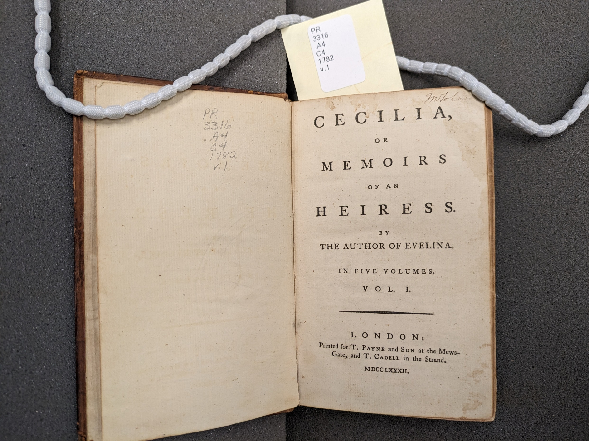

Frances Burney’s Cecilia and Digital Humanities
tiny.utk.edu/Cecilia
Dr. Hilary Havens
University of Tennessee University of York
May 28, 2024

Slide 2
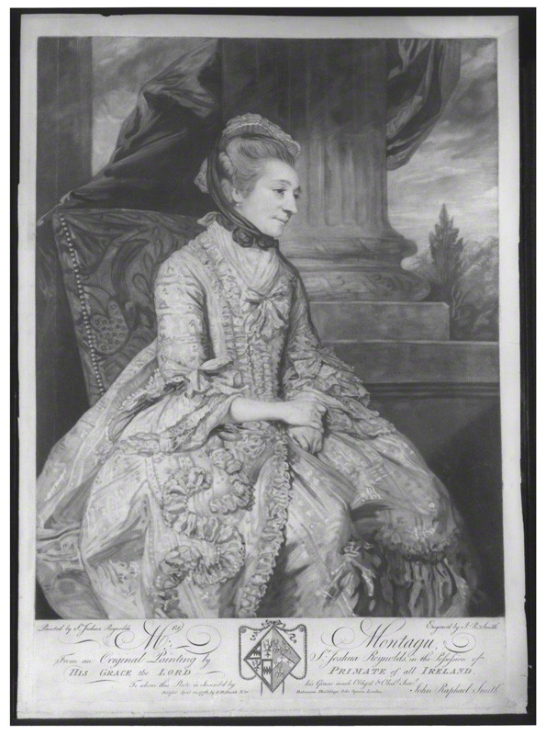
Engraving of Elizabeth Montagu (1776)

Slide 3
Correspondence on The Witlings and Cecilia
I am glad the objections all fall on the Stocking-Club-Party – as my chief & almost only quarrel was with its Members. As it is, not only the Whole Piece, but the plot had best be kept secret, from every body…
You have resources sufficient for Writing a great deal – only, for the stage, I w^{d} have you very Careful, & very Perfect – that is, as far so as your own Efforts, & the best advice you can get, can make you. In the Novel Way, there is no danger – & in that, no Times can affect ye. (Charles Burney to FB, 29 August 1779)
“The conflict scene for Cecilia, between the mother & son, to which you so warmly object, is the very scene for which I wrote the whole Book! & so entirely does my plan hang upon it, that I must abide by its reception in the World, or put the whole behind the Fire.” (FB to Crisp, 14 March 1782)

Slide 4
Correspondence on Cecilia (cont.)
I think the Book, in its present conclusion, somewhat original, for the Hero & Heroine are neither plunged in the depths of misery, nor exalted to unhuman happiness, — Is not such a middle state more natural? more according to real life, & less resembling every other Book of Fiction?
Besides, my own End will be lost, if I change the conclusion, which was chiefly to point out the absurdity & shortsightedness of those Name-compelling wills, which make it always presumed a Woman marries an Inferior, since he, not she, is to leave his own Family, in order to be incorporated into hers. You find, my dear Daddy, I am prepared to fight a good Battle here, but I have thought the matter much over, & if I am made give up this point, my whole plan is rendered abortive, & the last page of any Novel in Mr. Noble’s circulating Library may serve for the last page of mine, since a marriage, a Reconciliation, & some sudden expedient for great Riches, concludes them all alike. In every thing else you have pointed out, I shall either wholly change, or greatly alter. And I will be very diligent to improve & mend the whole. (FB to Crisp, 6 April 1782)

Slide 5
Correspondence on Cecilia (cont.)
I think the Book, in its present conclusion, somewhat original, for the Hero & Heroine are neither plunged in the depths of misery, nor exalted to unhuman happiness, — Is not such a middle state more natural? more according to real life, & less resembling every other Book of Fiction?
Besides, my own End will be lost, if I change the conclusion, which was chiefly to point out the absurdity & shortsightedness of those Name-compelling wills, which make it always presumed a Woman marries an Inferior, since he, not she, is to leave his own Family, in order to be incorporated into hers. You find, my dear Daddy, I am prepared to fight a good Battle here, but I have thought the matter much over, & if I am made give up this point, my whole plan is rendered abortive, & the last page of any Novel in Mr. Noble’s circulating Library may serve for the last page of mine, since a marriage, a Reconciliation, & some sudden expedient for great Riches, concludes them all alike. In every thing else you have pointed out, I shall either wholly change, or greatly alter. And I will be very diligent to improve & mend the whole. (FB to Crisp, 6 April 1782)

Slide 6
Correspondence on Cecilia (cont.)
What was the Result of these, my Meditations? — to enter into particulars would be endless: but the Sum total amounts to this — a full, unlimited Confirmation of my warm approbation of the Whole Work together; & a positive declaration of the improvements it has receiv’d, beyond all Expectation: — greatly, & judiciously compress’d; long Conversations curtail’d: several incidents much better manag’d; & the Winding up of the bottom beyond all Compare, more happy, more judicious more satisfactory — many particulars, which I did not quite relish, are soften’d off to a degree, that if I do not perfectly assent to, I hardly | know how to condemn (Crisp to FB, 25 July 1782).

Slide 7
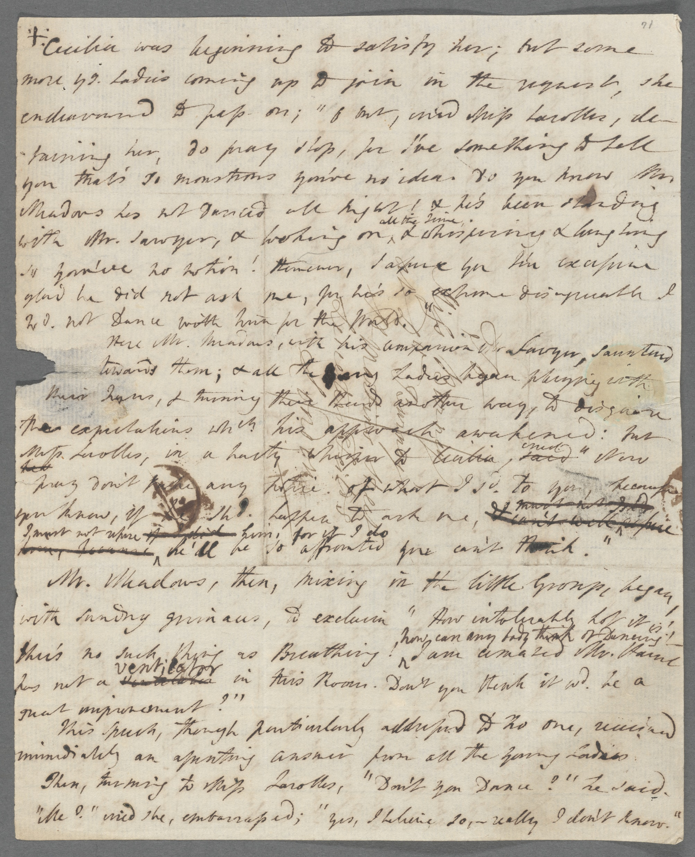
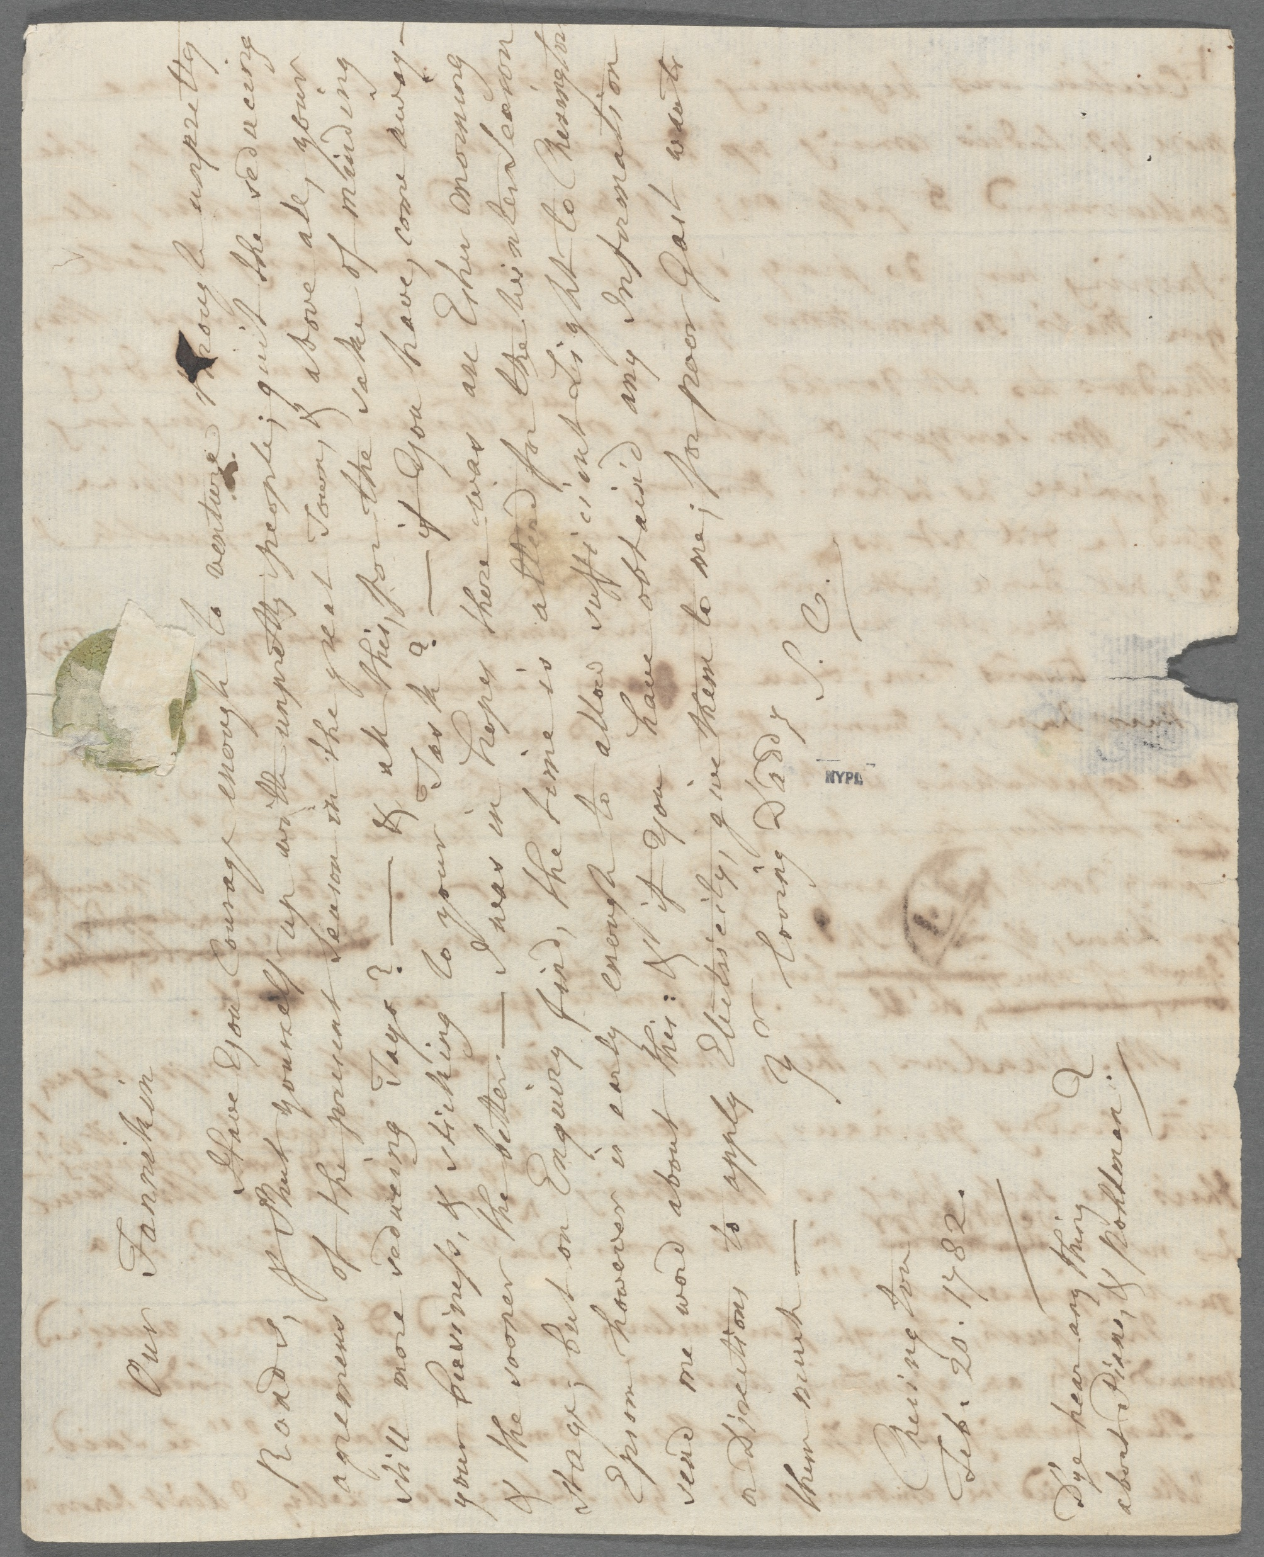

Slide 9
Our Fannikin
Have You Courage enough to venture through unpretty Roads, & Shut yourself up with unpretty people; quit the seducing agremens of the present Season in the great Town, & above all, your still more seducing Tays? – & all this, for the sake of minding your business, & sticking to your Task? – if you have, come away – & the sooner the better – I was in hopes there was an Esher morning Stage, but on Enquiry find, the time is altered for the Winter Season{.} Epson however is early enough to allow sufficient Light to Chesington {–} send me word about this: & if you have obtain’d any Information or Directions to apply Eleetss’eily, give them to me; for poor Gast wants them much –
Yr loving Daddy
S.C.
Chesington
Feb. 20. 1782.
D’ye hear any thing about Piano & Pohlman?

Slide 10
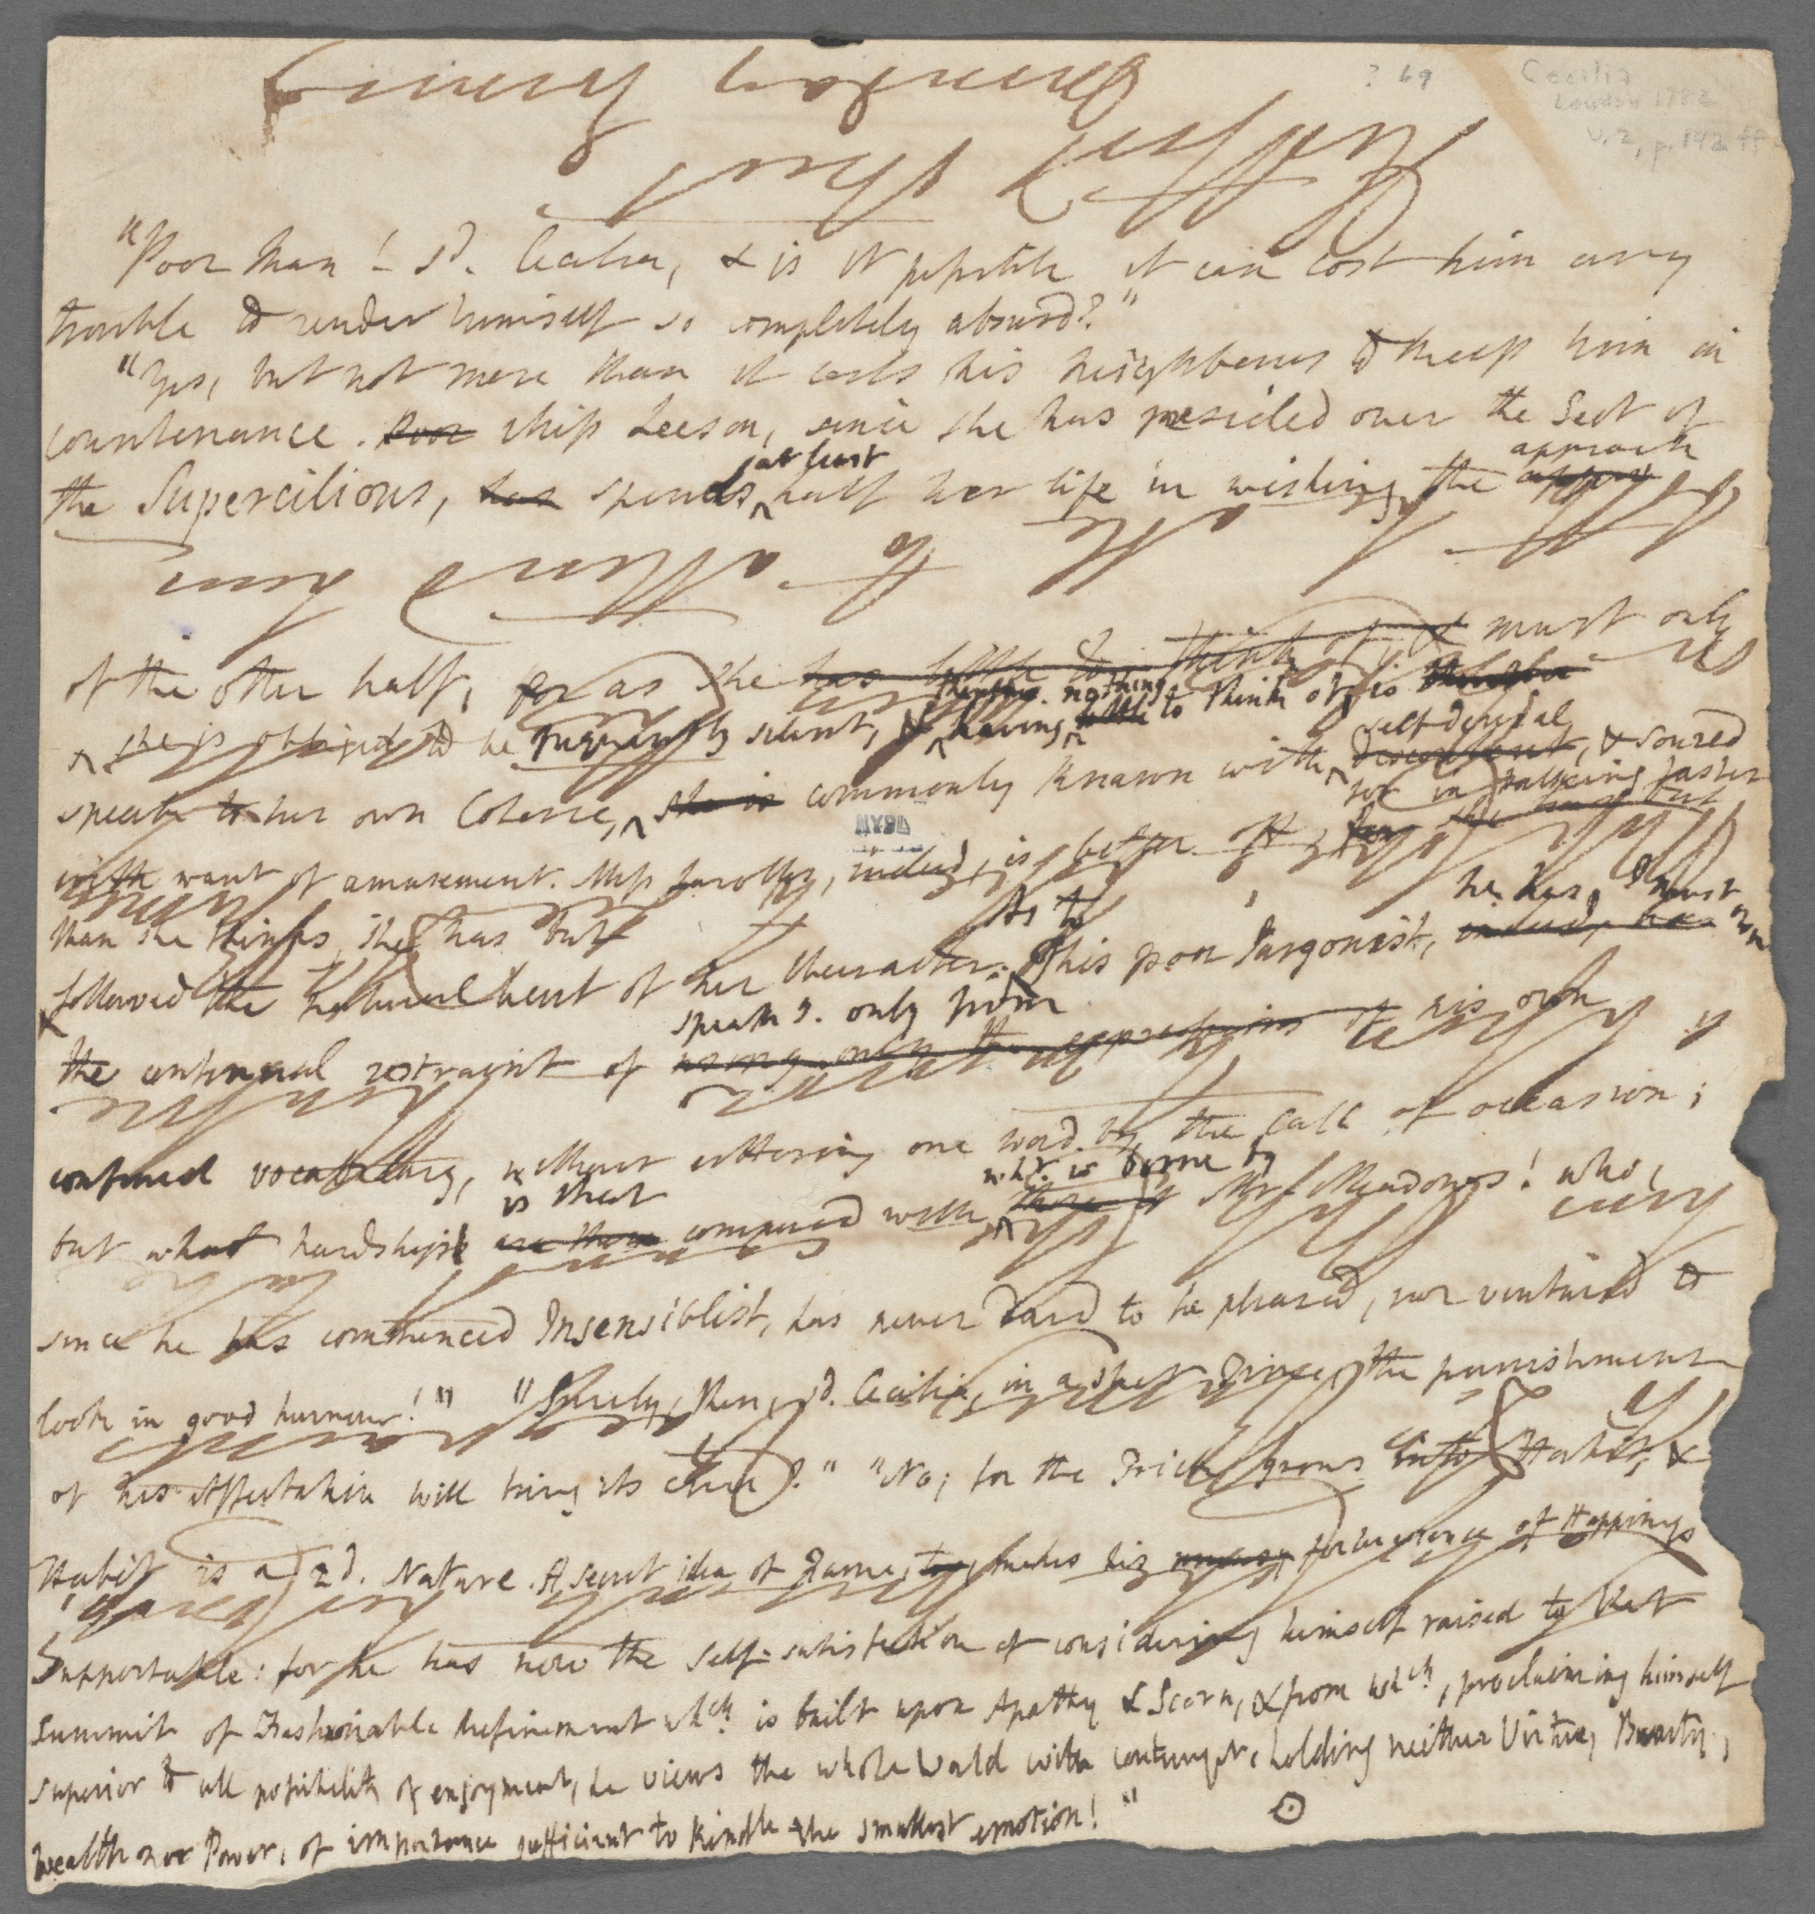

Slide 11
Lady Che presents her Comp^{ts}
to D^{r}. Burney to acquaint
him Miss Che cannot take
a lesson to morrow <Therefore>
Miss Che’s hope to see D^{r}. Burney
on <Friday> when they <will>
both be able to attend him
<Hertford> Street
Monday Evening

Slide 12
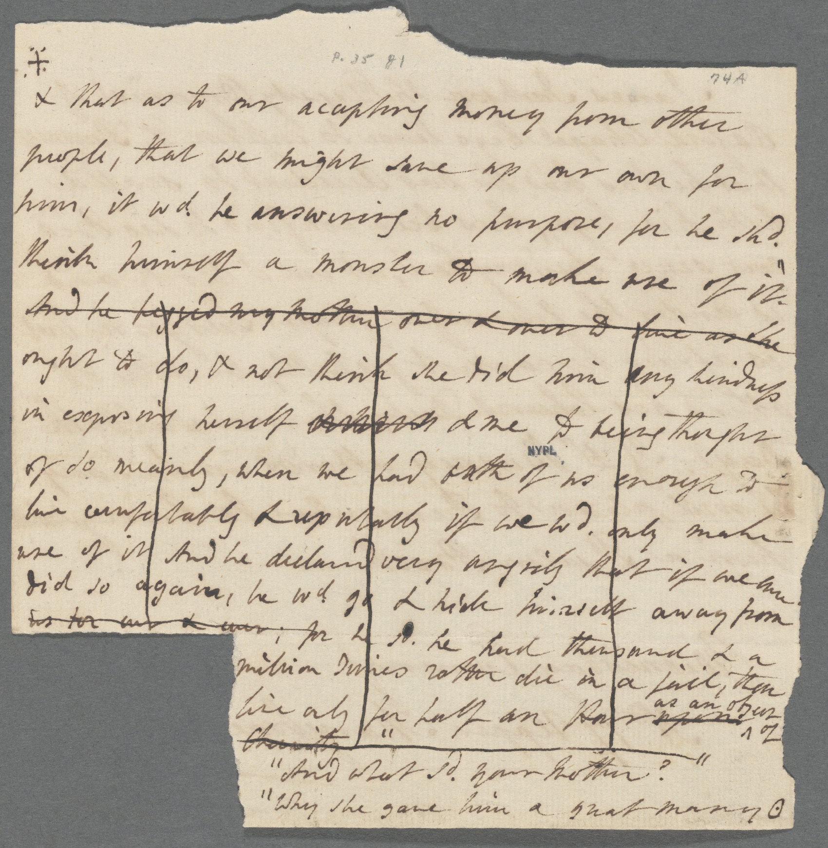
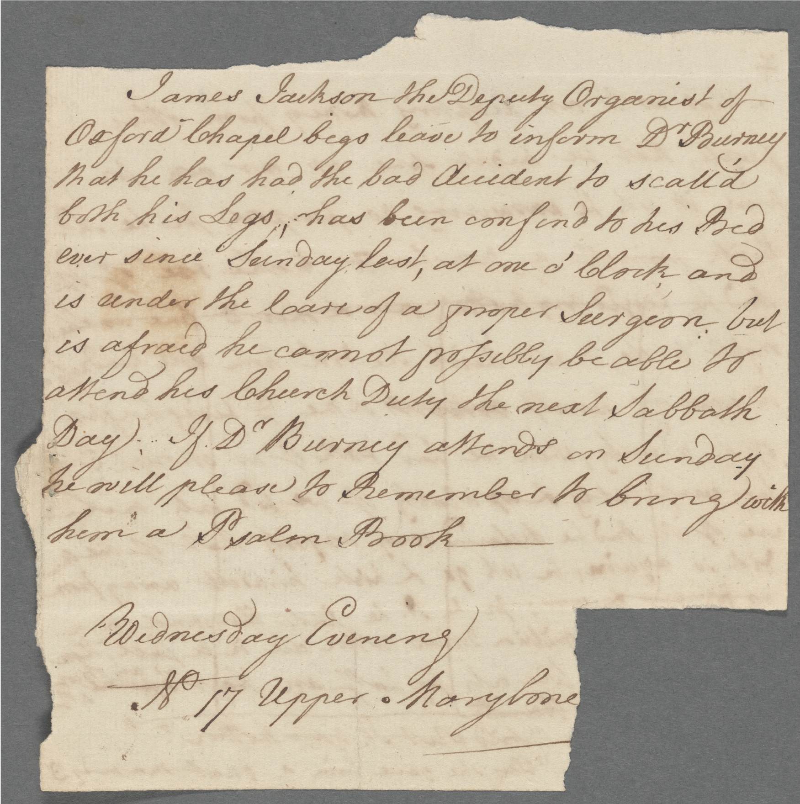

Slide 13
James Jackson the Deputy Organist of
Oxford Chapel begs leave to inform D^{r} Burney
that he has had the bad Accident to scall'd
both his Legs, has been confind to his Bed
ever since Sunday last, at one o’clock and
is under the Care of a proper Surgeon but
is afraid he cannot possibly be able to
attend his Church Duty the next Sabbath
Day. If D^{r} Burney attends on Sunday
he will please to Remember to bring with
him a Psalm Book ---
Wednesday Evening
Nº 17 Upper Marybone

Slide 14
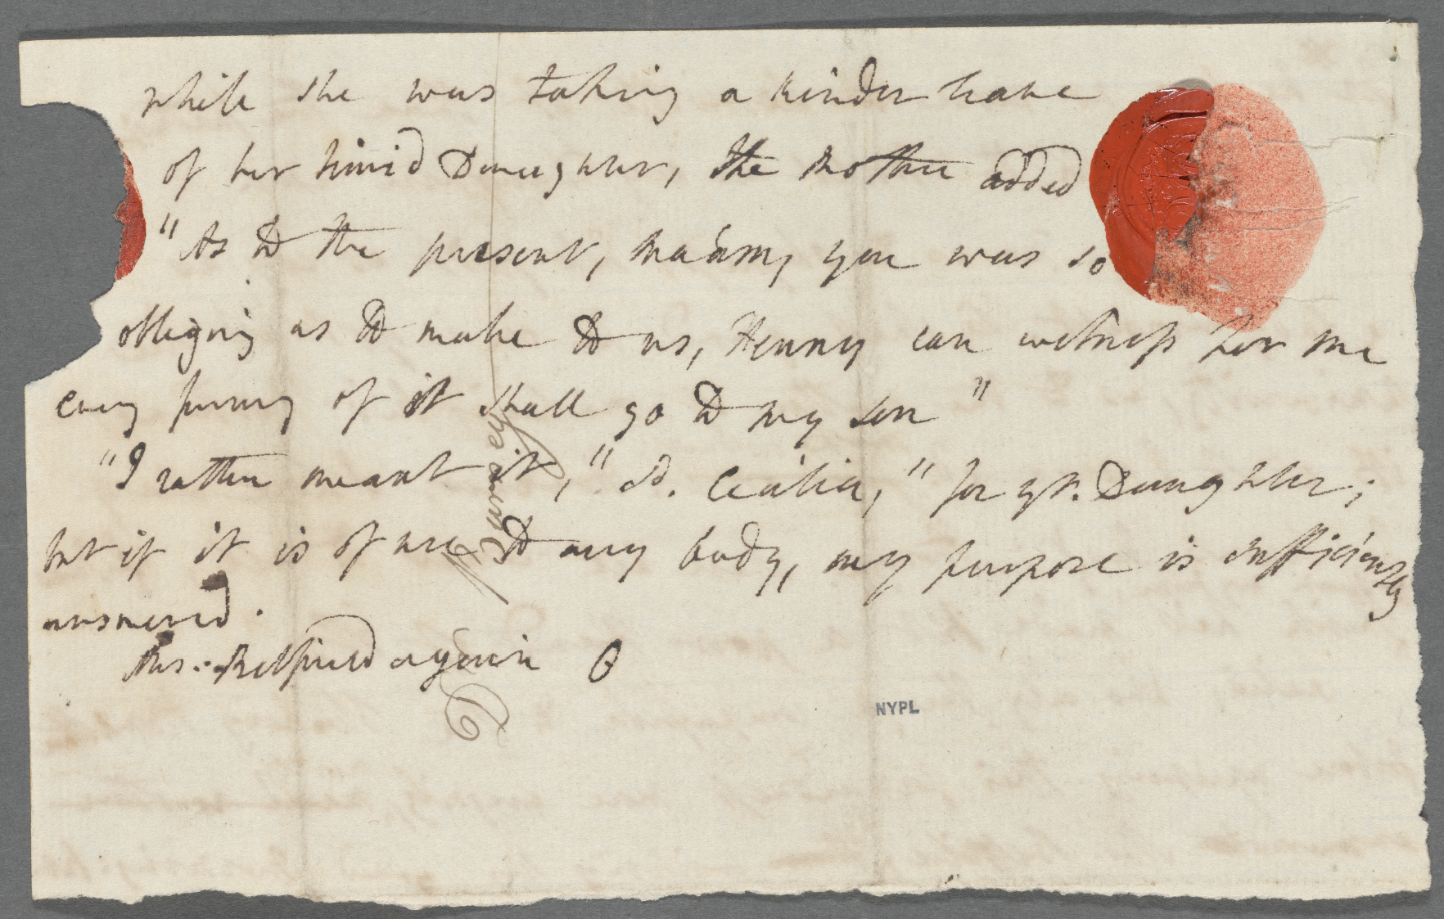

Slide 15
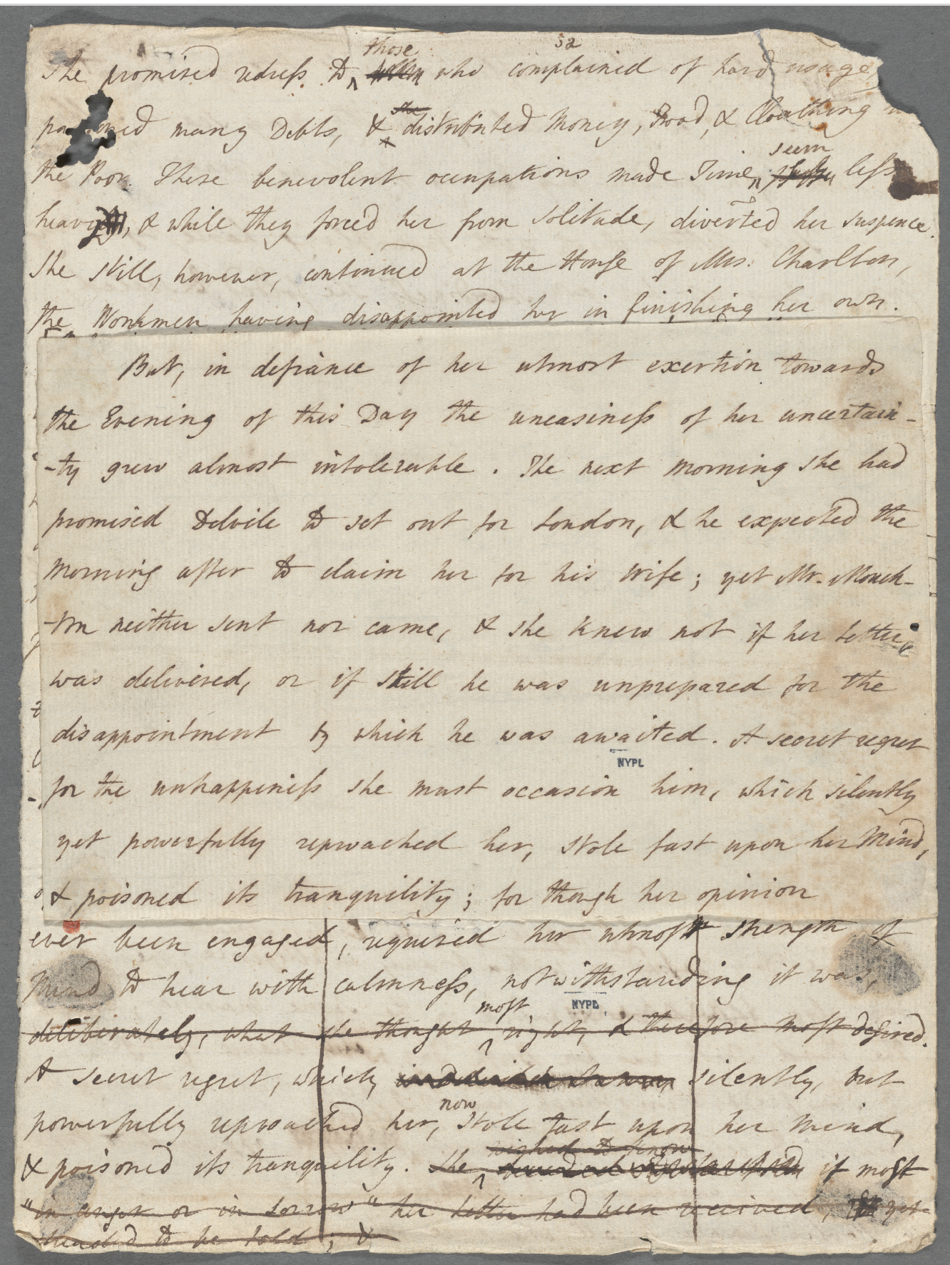
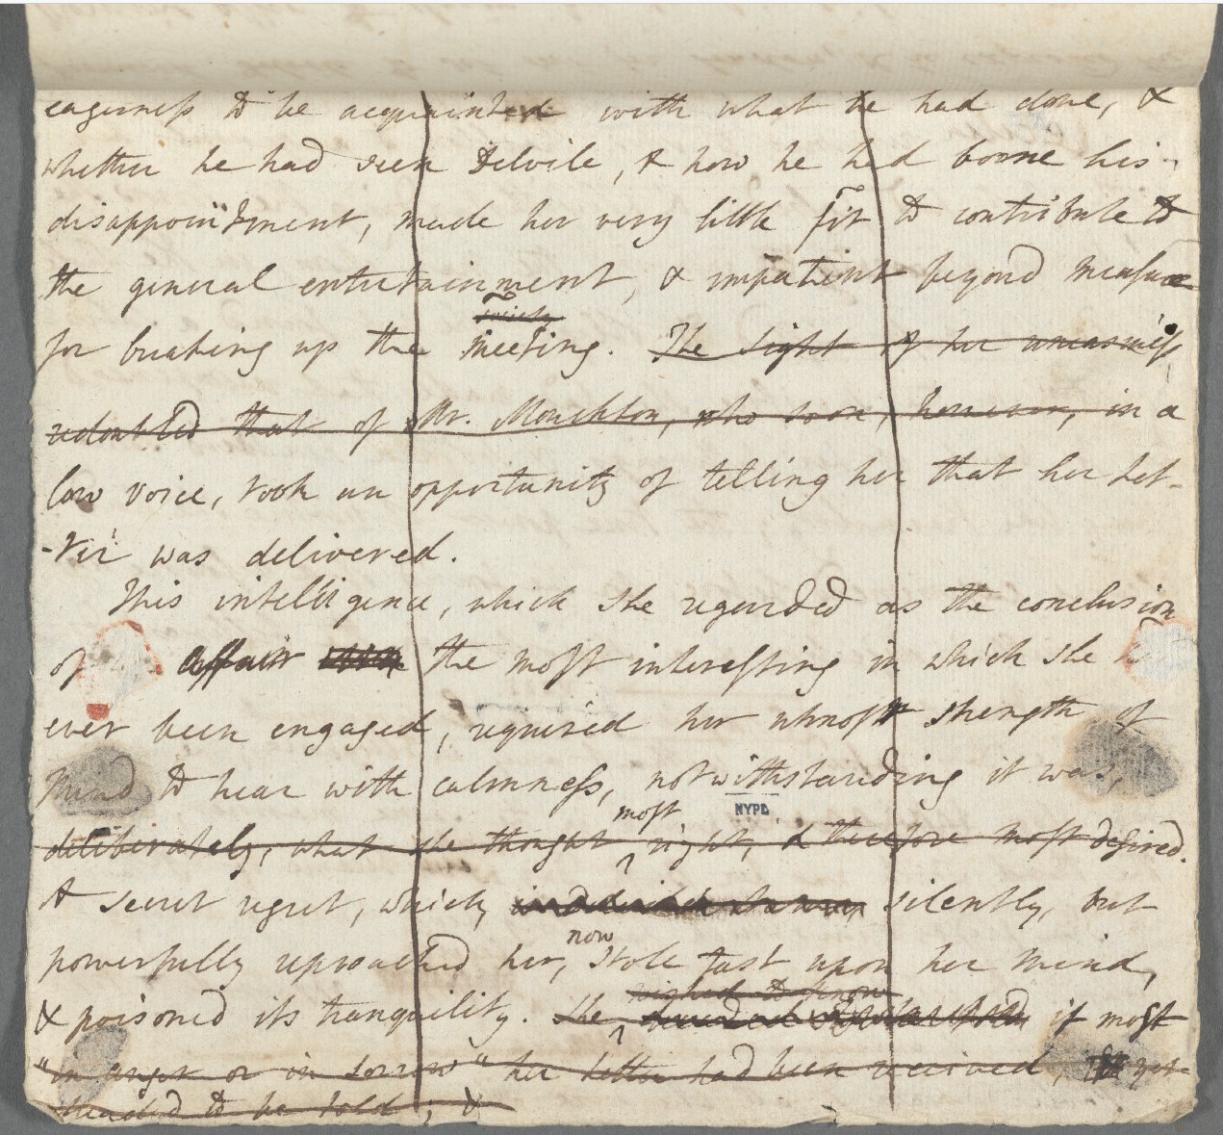

Slide 16
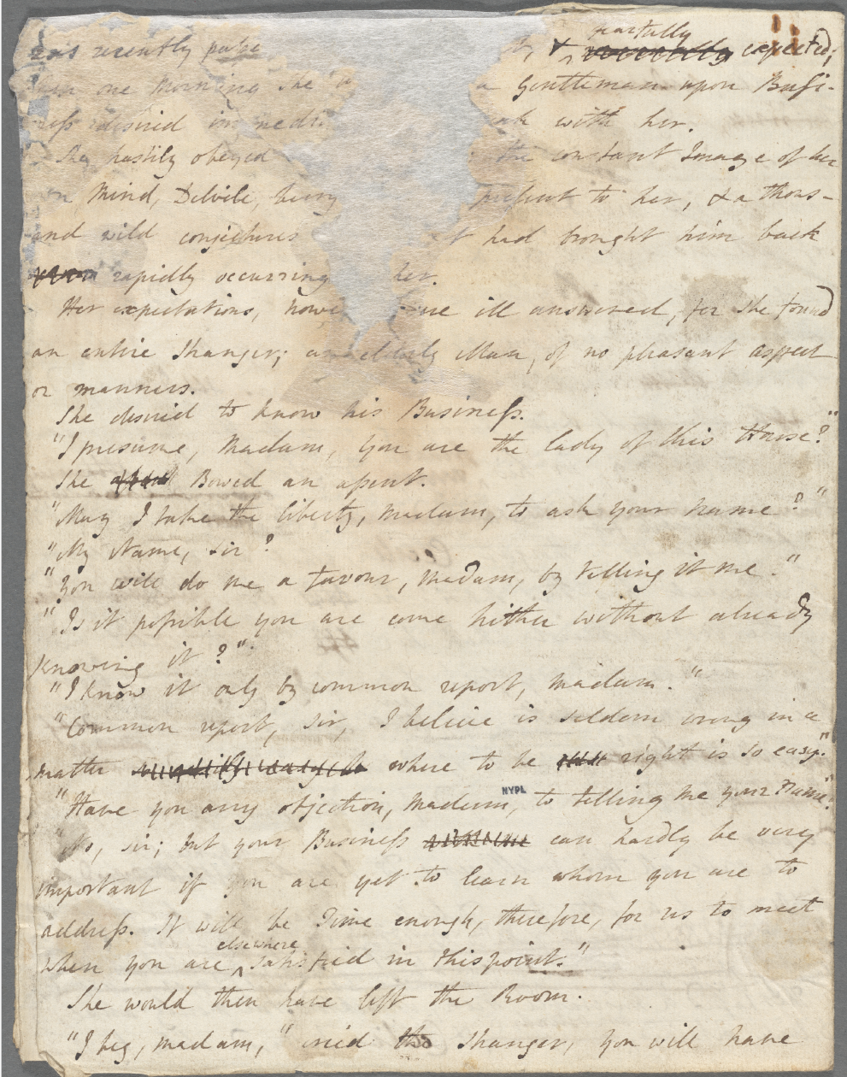

Slide 17


Slide 18
she could then shew some taste and discernment in her choice of friends, and she resolved to select such only as by their piety could elevate her mind, by their knowledge improve her understanding, or by their accomplishments and manners delight her affections. (vol.1, book 1, ch. 7)
she might ^{could} then shew some taste & discernment in her <xxxxx 1 word> ^{selection} ^{choice of Friends,} & selection of Favorites & she resolved to admit ^{select} such only as by their Piety could elevate her Mind, by their knowledge improve her understanding, by their Wit enliven her Spirit, or by their accomplishments & manners delight her affections. (MS 1: 111-12, my emphasis)

Slide 19
she knew the too great probability that the high spirit of Belfield would disdain making the explanation which Delvile in his present agitation might require, and the consequence of such a refusal must almost inevitably be fatal. (vol. 5, bk. 10, ch. 6)
she knew the too great probability that the high spirit of Belfield would disdain making the explanation which Delvile in his present agitation might require, & the consequence of such a refusal might must almost inevitably be a would be an immediate Challenge must almost inevitably be fatal if not a ^{an immediate} Duel without delay. <She> <xxxxx 1-2 words> <dared even> <hope> to <meet> Delvile, though destitute of all <means> of <pursuing> him, nothing <remained> for her <now but> to obey his <injunction> in waiting for <him where> he <had> himself directed. (MS 3: 286^{v}, deletions in red)

Slide 20
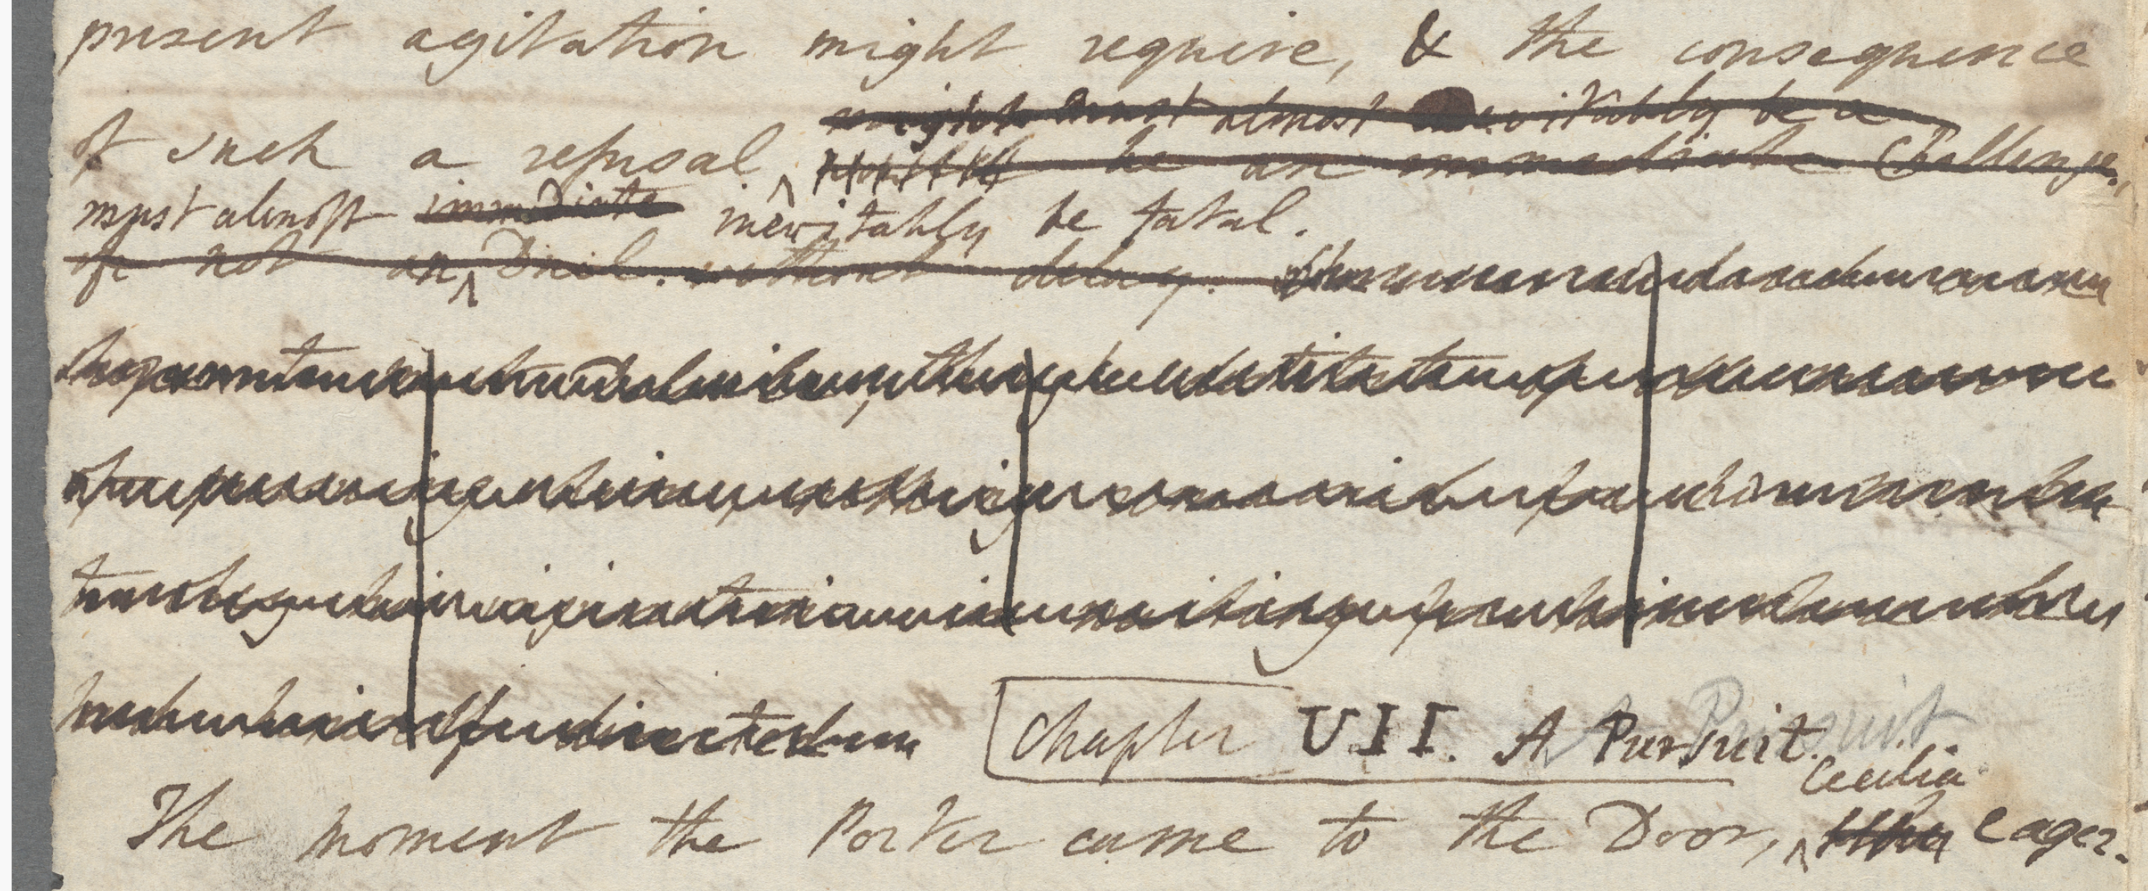

Slide 21
“I have nothing more to give without I cut down my trees, or sell some farm, since all I was worth, except my landed property, is already gone. What, therefore, I can now do to save Mr. Harrel from this desperate expedition I know not.”
“I am sorry,” said Cecilia, “to speak with severity of one so nearly connected with you, yet, suffer me to ask, why should he be saved from it at all? and what is there he can at present do better? Has not he long been threatened with every evil that is now arrived? (vol. 2, bk. 3, ch. 9)
I have nothing more to part with ^{give} without I sell ^{cut down} my Trees or ^{sell} some Farm: for ^{Since} all ^{I was worth but} my ready ^{except my Landed} property in Land is already gone.
“I am both astonished & shocked at this acc^{t}, said Albina, & to find that y^{r}. sister’s connection with Mr. Harrel has been as unfortunate for you as for her ^{for herself}. I am sorry to speak severely ^{with severity} of one for nearly allied to you, but the too great ascendant which he has gained over yr. soft & compassionate mind, will end in yr. utter ruin if you are not made sensible of y^{r}. danger: be steady, therefore, in refusing to part even with an Inch of Land, for if there you once waver depend upon it you are undone!”
“I never, answered he, thought even for a moment of this expedient, till Mr. Harrel talked of going Abroad & refused to leave my sister behind him”
“Mr. Arnott, s^{d}. she, I have rec^{d}. good advice myself from a Man well acquainted with the World, & I will now, though merely as his Pupil, endeavour to give some to you. Consider, then, for a Moment, what in reality is the objection to Mr. Harrel’s going Abroad? In the manner he now goes on, he cannot live here, no, not if he were to spend thrice his own Fortune, & that of his best Friends besides: impartially speaking, what, then, can he do better? Has he not long been threatened with every evil that is now occurred? (MS 2: 92, my emphasis)

Slide 22
as he had sedulously watched her from her earliest years, he had reason to believe that her heart had escaped any dangerous impression. This being her situation, he had long looked upon her as his future property; as such he had indulged his admiration, and as such he had already appropriated her estate, though he had not more vigilantly inspected into her sentiments, than he had guarded his own from a similar scrutiny. (vol. 1, bk. 1, ch. 1)
as he had ^{sedulously} watched her ^{from her earliest years} conduct, enquired into her <emotions>, he had reason to believe that she had yet formed no Engagement, & that her Heart had escaped any dangerous impression. This being her situation, he had long regarded ^{looked upon} her as his future property, as such he had Courted her favour, indulged his admiration of her Person & as such had already appropriated her Estate, though he had never <xxxxx 1 word> before that <the most> not having the smallest <xxxxx 1 word> distant hint of his purpose to escape him. but that, <with> the recovery of his <liberty, he> <should> find her Beauty <&> her Fortune entirely at his disposal. though he had not more vigilantly <xxxxx 1 word> inspected into her sentiments, than he had guarded his own from a similar scrutiny. (MS 1: 13, deletions in red)

Slide 23
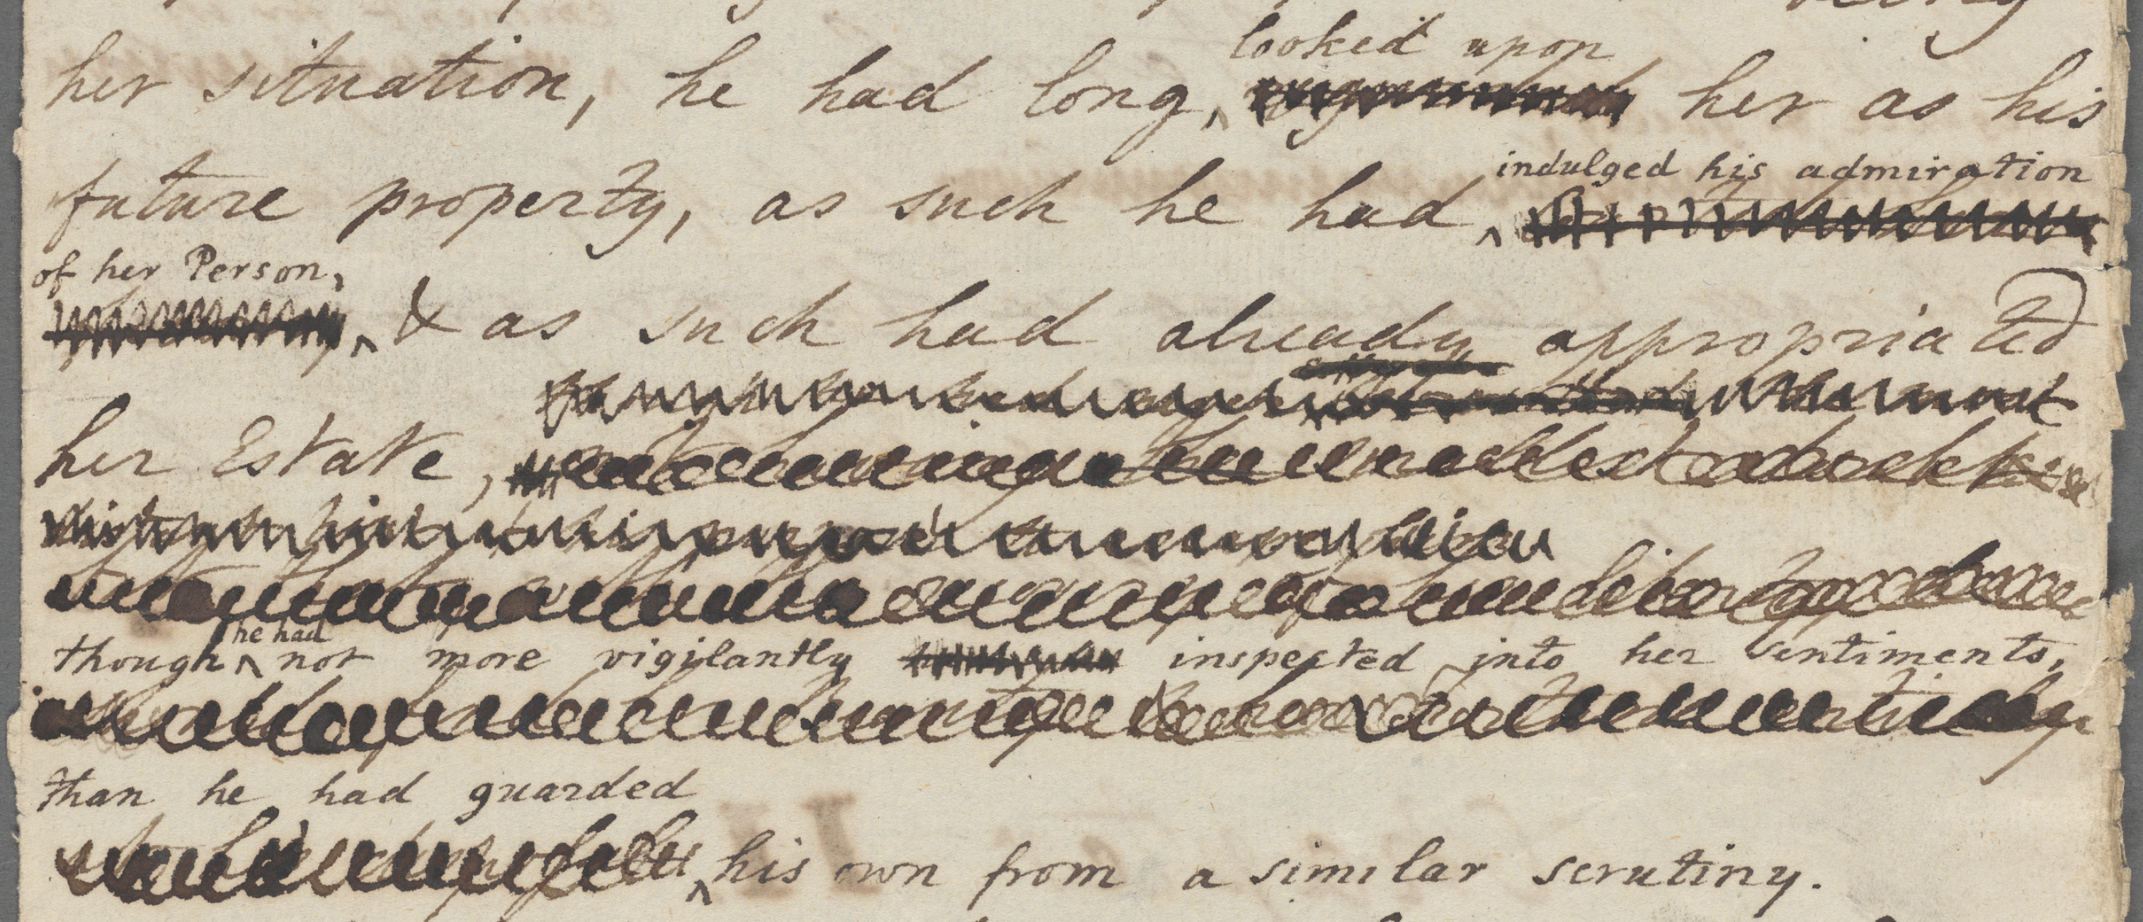

Slide 24
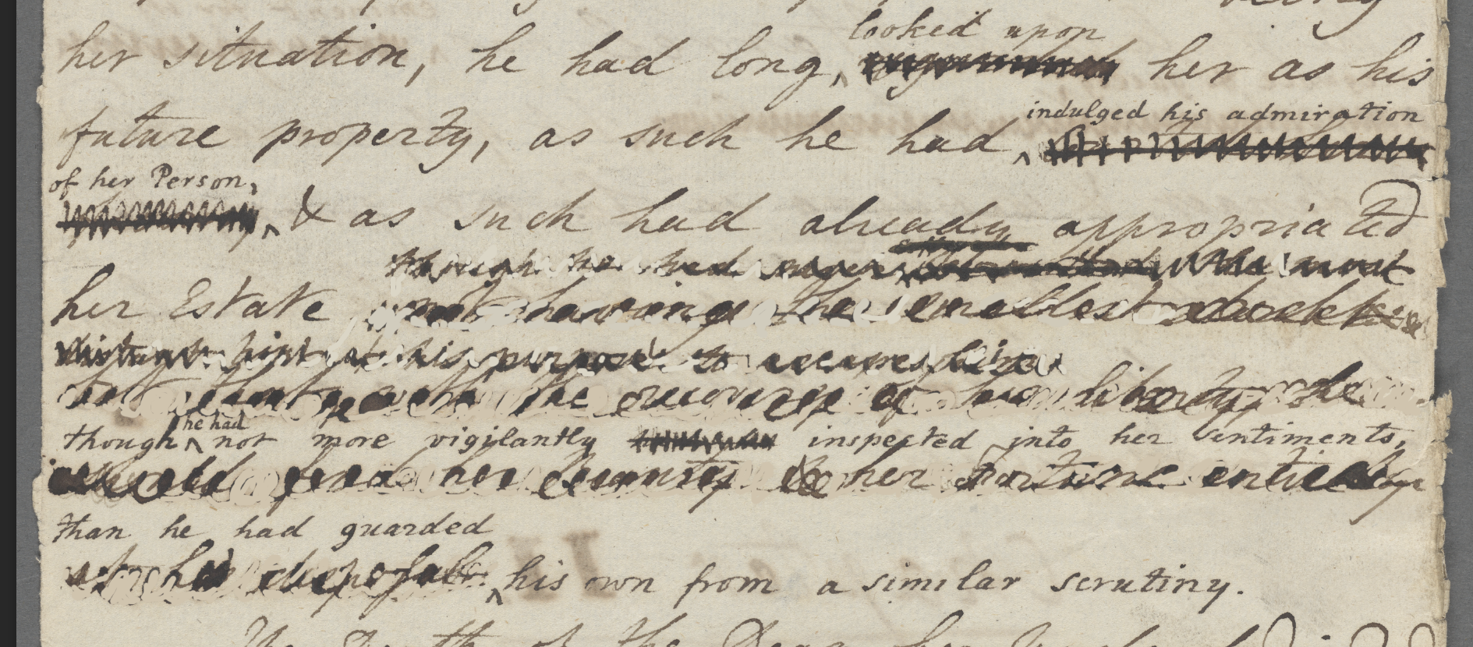

Slide 25
the unaffected joy with which Cecilia had received Mr. Monckton, had struck him with a sensation of envy as involuntary as it was painful: he did not, indeed, suspect that gentleman’s secret views; no reason for suspicion was obvious (vol. 1, book 1, ch. 7)
the unaffected joy with which Albina ^{Cecilia} had received Mr. Monckton, had struck him with a sensation of envy as involuntary as it was painful: he did not, indeed, imagine that she <loved> him, satisfied of the purity of her Heart, he believed her incapable of <cherishing> the <most <xxxxx 1 words> not emotion> that the whole World might not know, but still, she received <him> with pleasure! – <neither> was he suspicious of <Mr. Monckton>suspect that gentleman’s secret pretensions & views; no reason for suspicion was obvious (MS 1: 65-66)

Slide 26
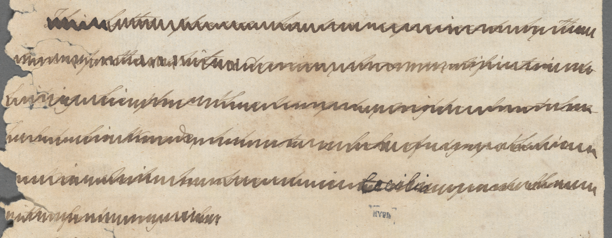
This latter pleasure [in tormenting others] he soon experienced by the
<return> of the white Domino, <whose> mortification at
having his place thus usurped, might <least have
healed> his <Wound>, had not a look of sympathetic
<emotion> which he observed in ^{Cecilia} <opened there
<with> fresh anguish>. (MS 1: 260, cf. vol. 1, book 2, ch. 3)

Slide 27
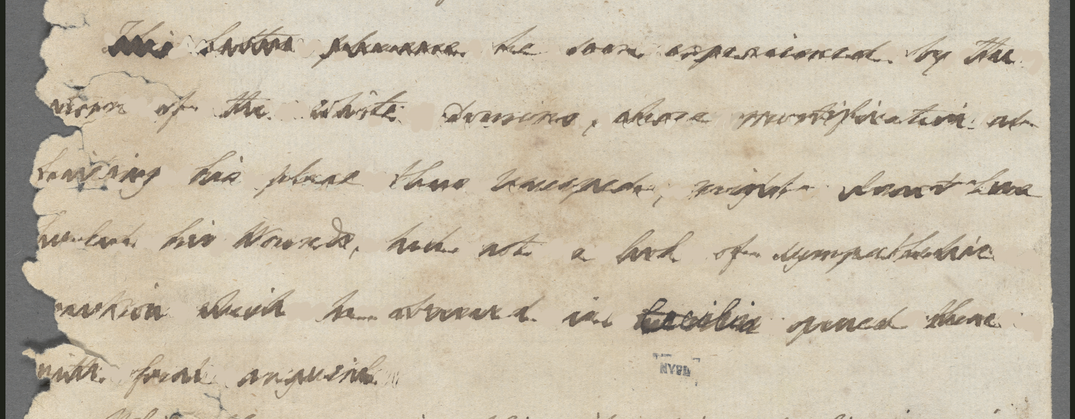
This latter pleasure [in tormenting others] he soon experienced by the
<return> of the white Domino, <whose> mortification at
having his place thus usurped, might <least have
healed> his <Wound>, had not a look of sympathetic
<emotion> which he observed in ^{Cecilia} <opened there
<with> fresh anguish>. (MS p. 260, cf. vol. 1, book 2, ch. 3)

Slide 28
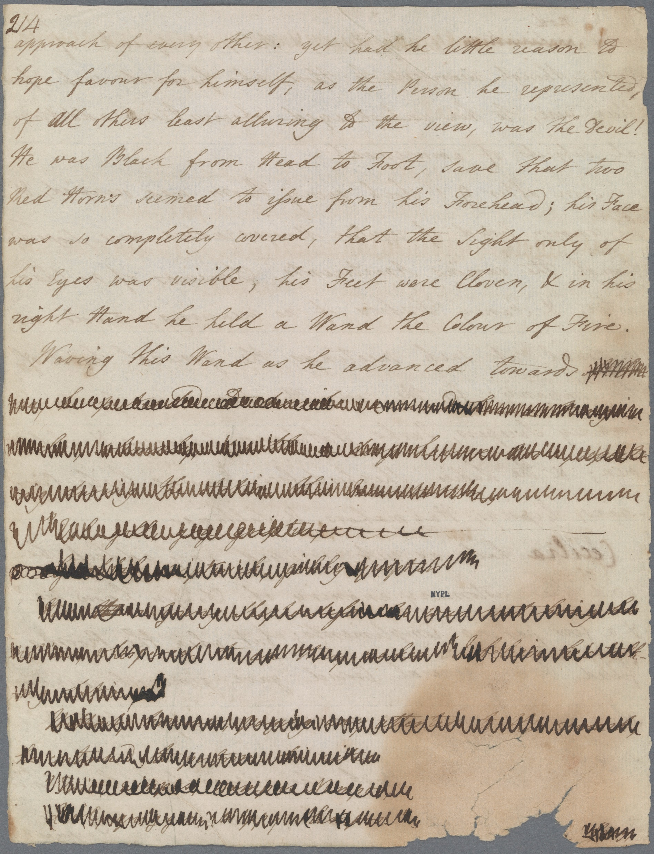
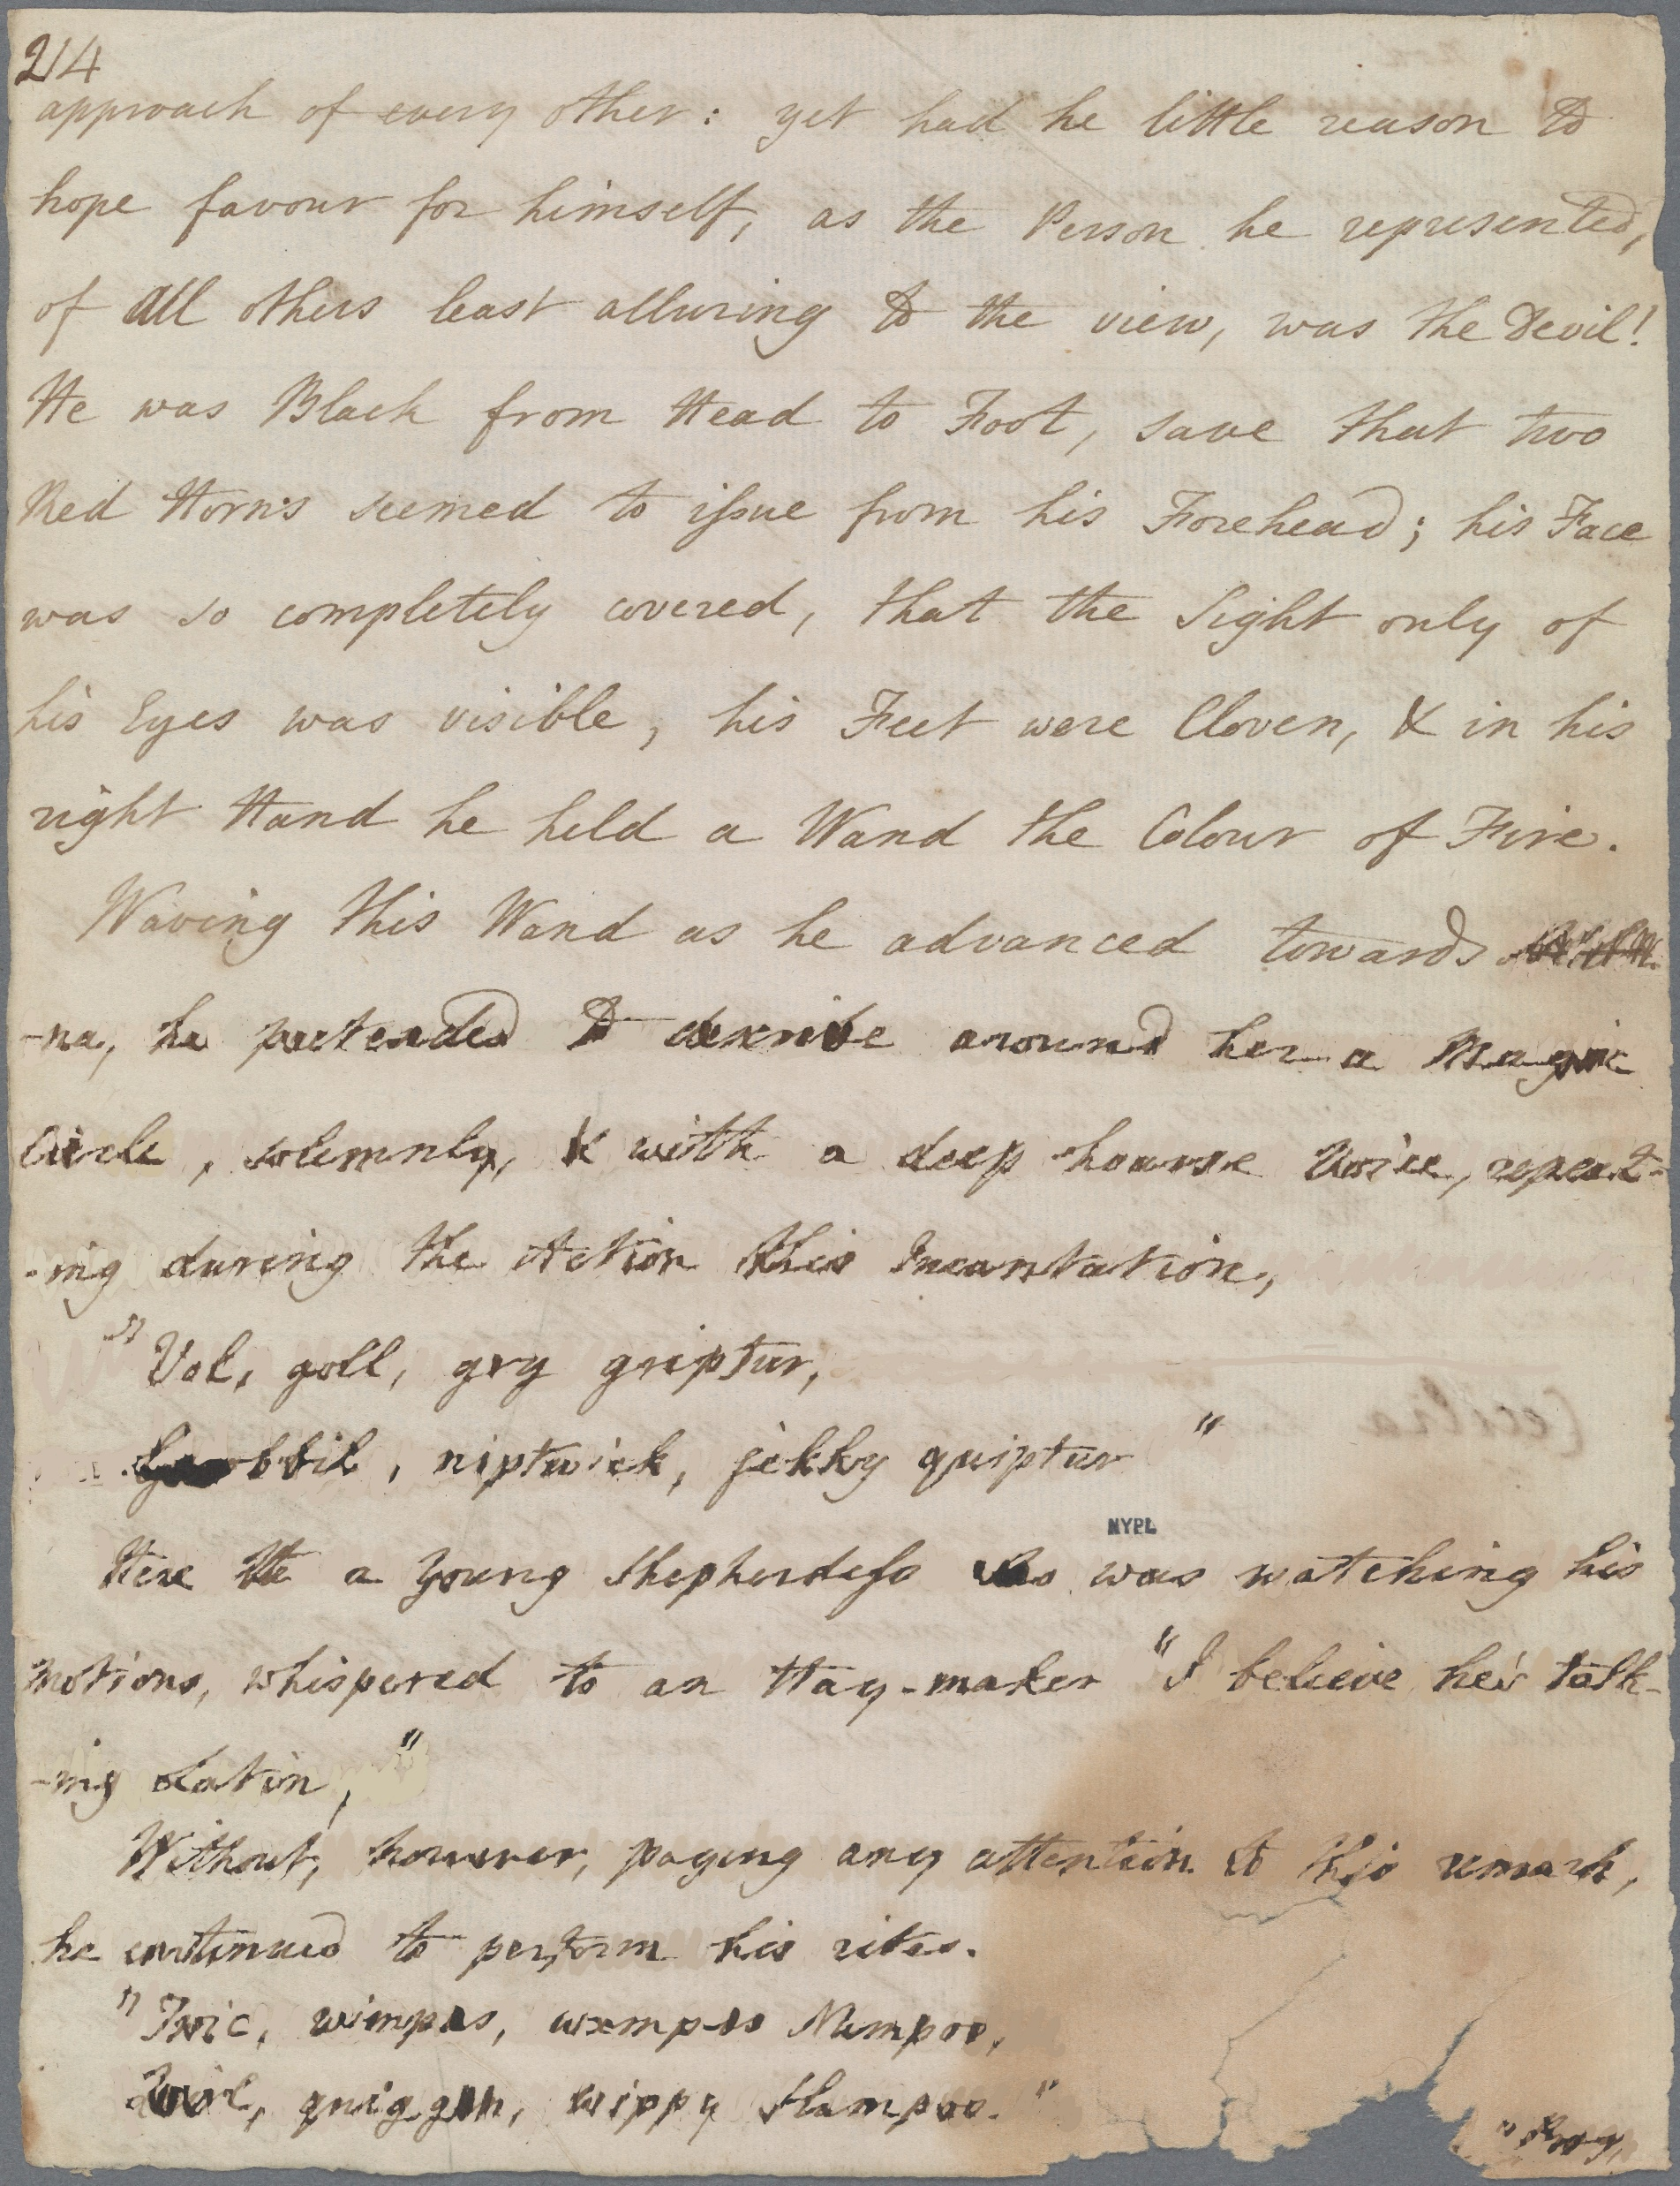

Slide 29
Waving this wand as he advanced towards <Albina>, he pretended to <describe> around her a Magic Circle, solemnly, & with a deep hoarse Voice, repeating during the Action this Incantation,
“Vol, goll, gry griptur,
<Goobbil>, niptwick, fikky quiptur”
Here a Young Shepherdess who was watching his motions, whispered to an Haymaker[,] “I believe he’s talking Latin,”
Without, however, paying any attention to this remark, he continued to perform his rites<.>
“Twic, <wimpas, wxmpis Mempos>
<Quirl, quiggon>, wippy <Slampos>.” (MS 1:214-5)

Slide 30
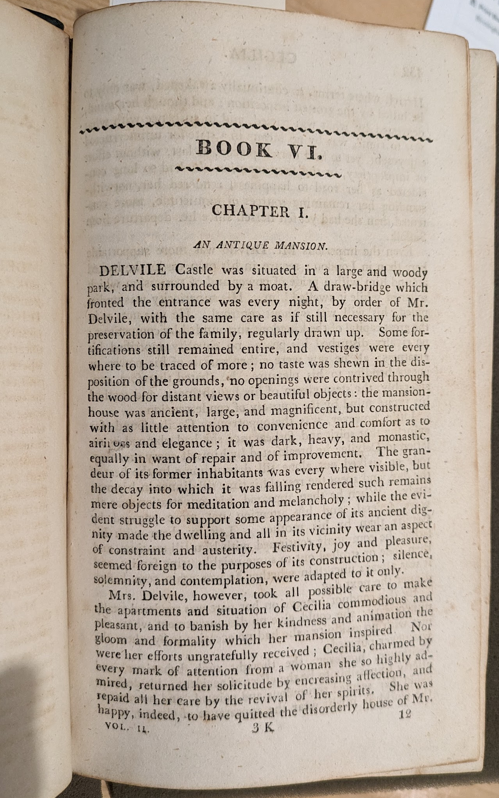
The first page of volume 2 of:
Cecilia; or, Memoirs of an Heiress. An Interesting Novel. By Miss Burney, Author of Evelina, and Other Valuable Productions. 2 vols. Birmingham: Printed and Sold by W. Suffield & Co., [1812?].

Slide 31
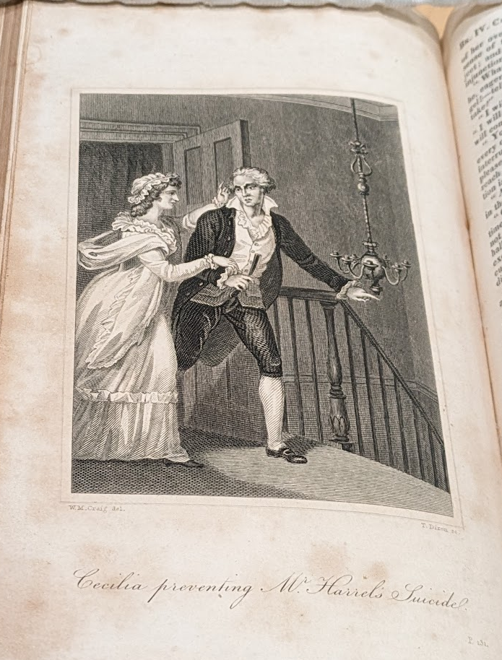
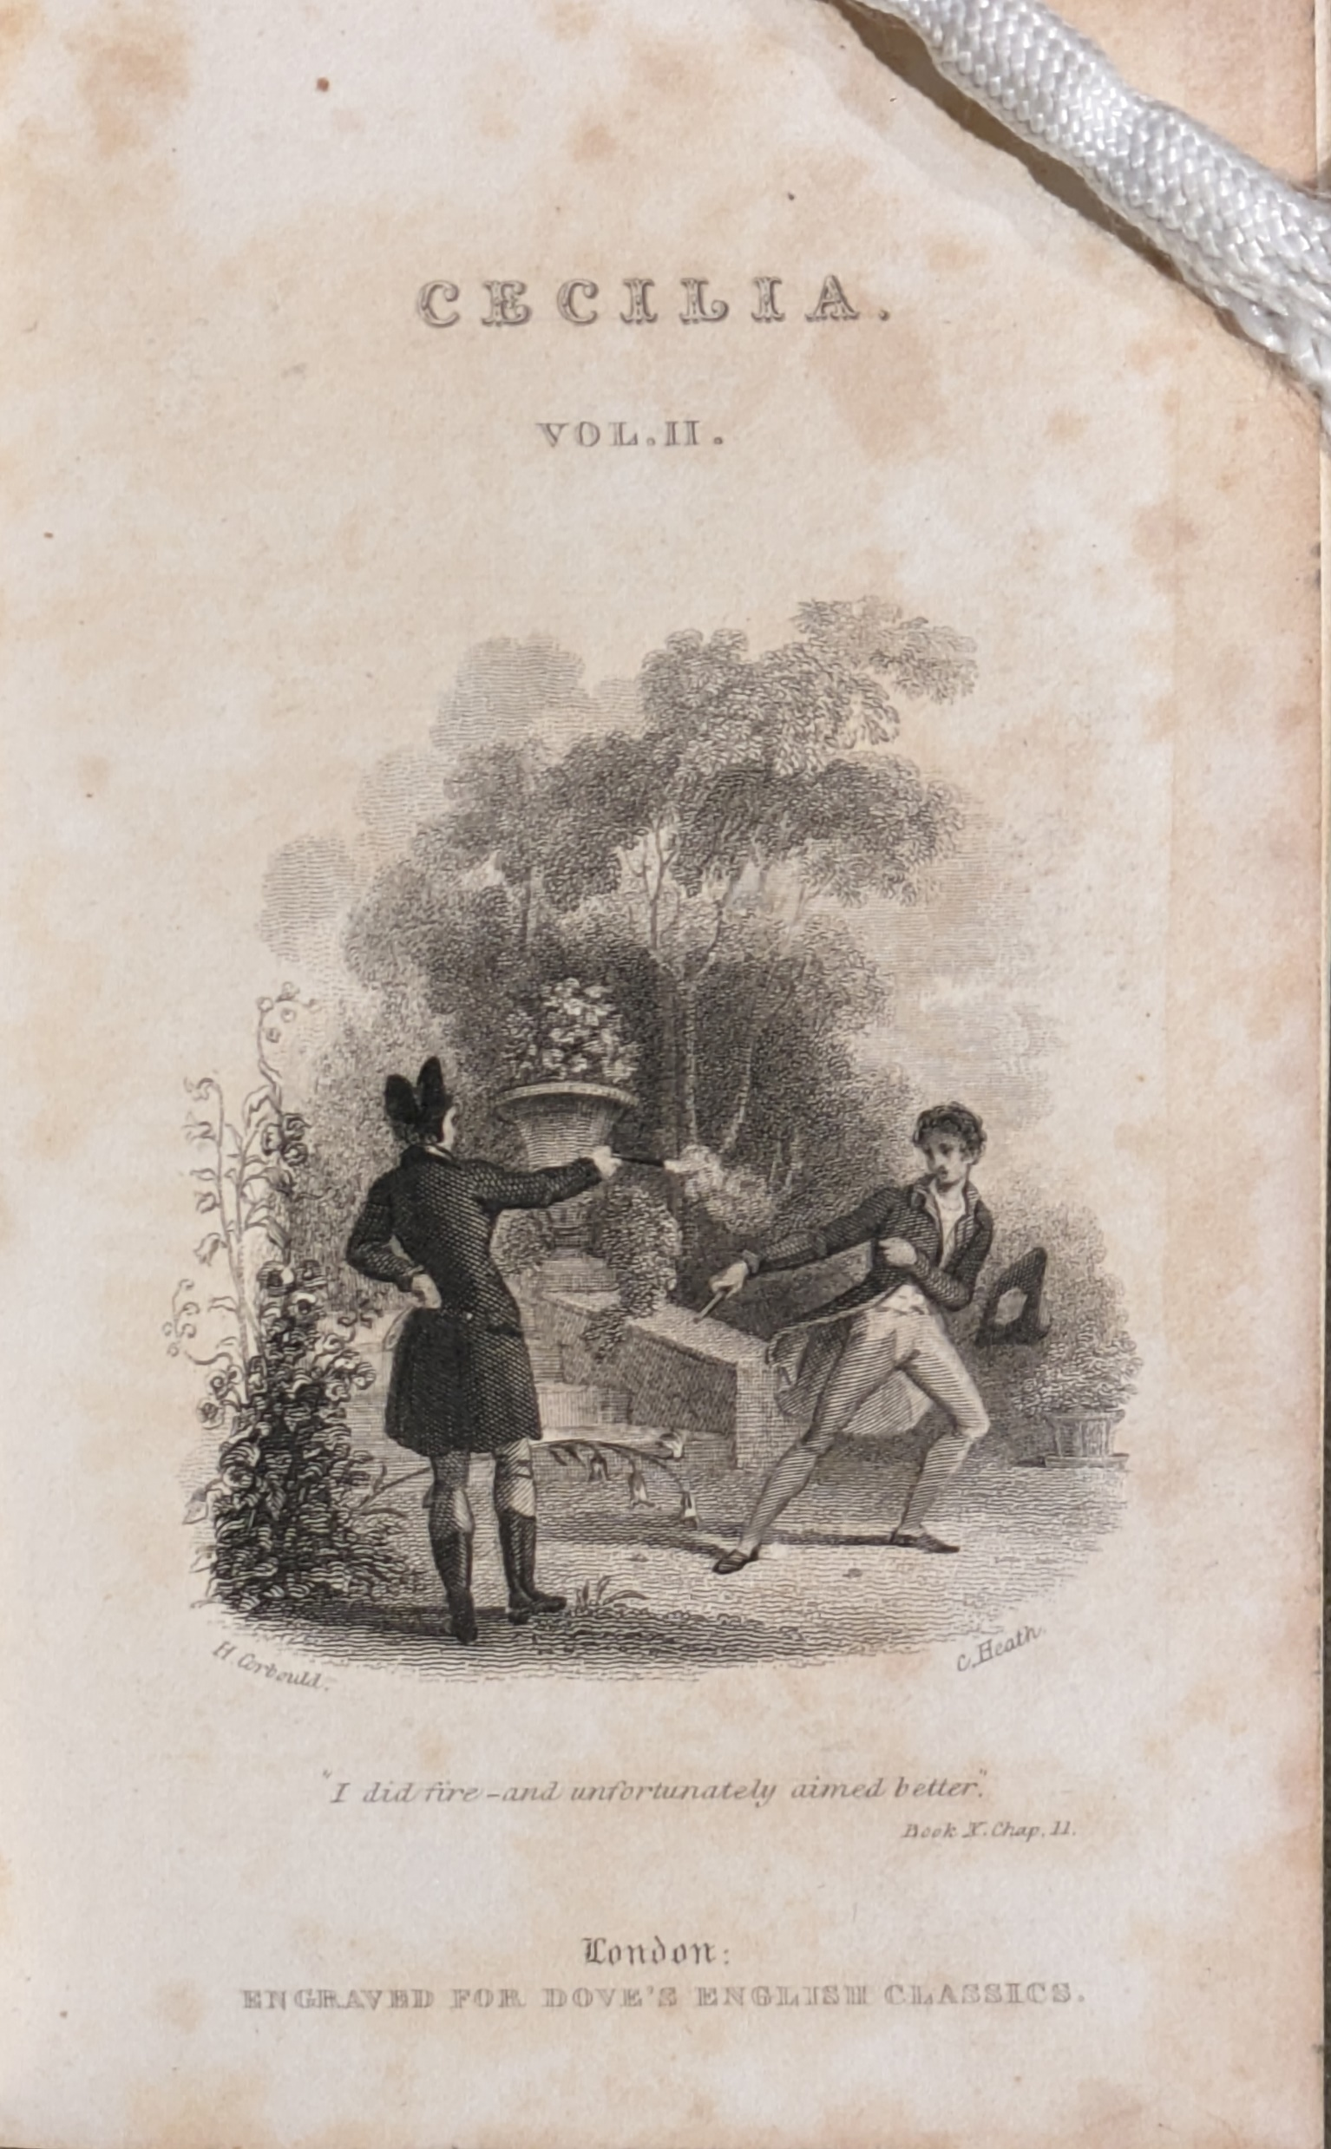
“Cecilia preventing Mr. Harrel’s Suicide”
Cecilia: or, Memoirs of an Heiress. By Madame D’Arblay. 1 vol. “Embellished with Elegant Engravings.” London: Printed at the Caxton Press, by Henry Fisher, “(Printer in Ordinary to His Majesty.)”, [Aug. 1822].
“I did fire – and unfortunately aimed better. Book X. Chap. II.” [Delvile firing on Monckton in a duel]
Cecilia: or, Memoirs of an Heiress. By Miss Burney. 2 vols. London: Printed and Published by J.F. Dove, St. John’s Square, “Engraved for Dove’s English Classics.” [1820].

Slide 32
Avoidance
Harrel:
And by this method, which he constantly practised, of avoiding any private conversation, he frustrated all her schemes of remonstrating upon his delay, since her resentment, however great, could never urge her to the indelicacy of dunning him in presence of a third person. (vol. 2, bk. 3, ch. 4)
Her next effort was to remonstrate with Mr. Harrel himself; but this scheme was not more easy of execution than the other, since Mr. Harrel, suspecting she meant again to dun him for her money, avoided all separate conversation with her so skilfully, that she could not find a moment to make him hear her. (vol. 2, bk. 3, ch. 8)
Monckton:
In the evening she had again a visit from Mr. Monckton, who, though he was now acquainted how much she was at home, had the forbearance to avoid making frequent use of that knowledge, that his attendance might escape observation. (vol. 1, bk. 2, ch. 3)
Mr. Monckton, though his principal study was carefully to avoid all public gallantry or assiduity towards Cecilia, had not the forbearance to resist this intimation, and therefore she had the pleasure of telling Sir Robert, when he asked the honour of her hand for the two first dances, that she was already engaged. (vol. 3, bk. 5, ch. 1)

Slide 33
Avoidance (cont.)
Delvile:
he had evidently avoided her while it was in his power, and when, at last, he was obliged to meet her, he was formal, distant, and reserved. (vol. 3, bk. 5, ch. 1)
Delvile, far from manifesting any design of conquest, shunned all occasions of gallantry, and sedulously avoided even common conversation with her. (vol. 3, bk. 6, ch. 3)

Slide 34
Manipulation
Harrel:
Her terror was now inexpressible; she believed him in the very act of suicide, and her refusal of assistance seemed the signal for the deed…
At these words he opened it; his face was totally without colour, and he grasped a razor in his hand.
“You have stopt me,” said he, in a voice scarce audible, “at the very moment I had gathered courage for the blow: but if indeed you will assist me, I will shut this up,—if not, I will steep it in my blood!” (vol. 2, bk. 4, ch. 5)
Monckton:
“…is not any thing preferable to dwelling with Mr. Briggs?”
“Certainly,” said Mr. Monckton coolly, “nor should I have supposed he had any chance with you, had I not hitherto observed that your convenience has always been sacrificed to your sense of propriety.”
Cecilia, touched by praise so full of censure, and earnest to vindicate her delicacy, after an internal struggle, which Mr. Monckton was too subtle to interrupt, protested she would go instantly to Mr. Briggs, and see if it were possible to be settled in his house, before she made any attempt to fix herself elsewhere. (vol. 3, bk. 5, ch. 7)
“Good God,” cried he, “Miss Beverley, what is this you have done? bound yourself to marry a man who despises, who scorns, who refuses to own you!” (vol. 4, bk. 7, ch. 7)

Slide 35
Manipulation (cont.)
Delvile:
…weigh your objections against the consequences which must follow. It is discovered I attended you in town; it will be presumed I had your permission for such attendance: to separate, therefore, now, will be to no purpose with respect to that delicacy which makes you wish it….it will cast over your own conduct a veil of mystery and obscurity wholly subversive of that unclouded openness, that fair, transparent ingenuousness, by which it has hitherto been distinguished. (vol. 4, bk. 8, ch. 1)
…her consent to a clandestine action she lamented as an eternal blot to her character, and the undoubted publication of that consent as equally injurious to her fame. Neither retracting nor fulfilling her engagement could now retrieve what was past, and in the bitterness of regret for the error she had committed, she thought happiness unattainable for the remainder of her life. (vol. 4, bk. 8, ch. 1)
“Do you bring me any message from Mr. Monckton?”
“From Mr. Monckton?—no; but he lives and will recover.”
“I thought you had been Mr. Monckton yourself.”
“Too cruel, yet justly cruel Cecilia!—is then Delvile utterly renounced?—the guilty, the unhappy Delvile!—is he cast off for ever? have you driven him wholly from your heart? do you deny him even a place in your remembrance?” (vol. 5, bk. 10, ch. 8)

Slide 36
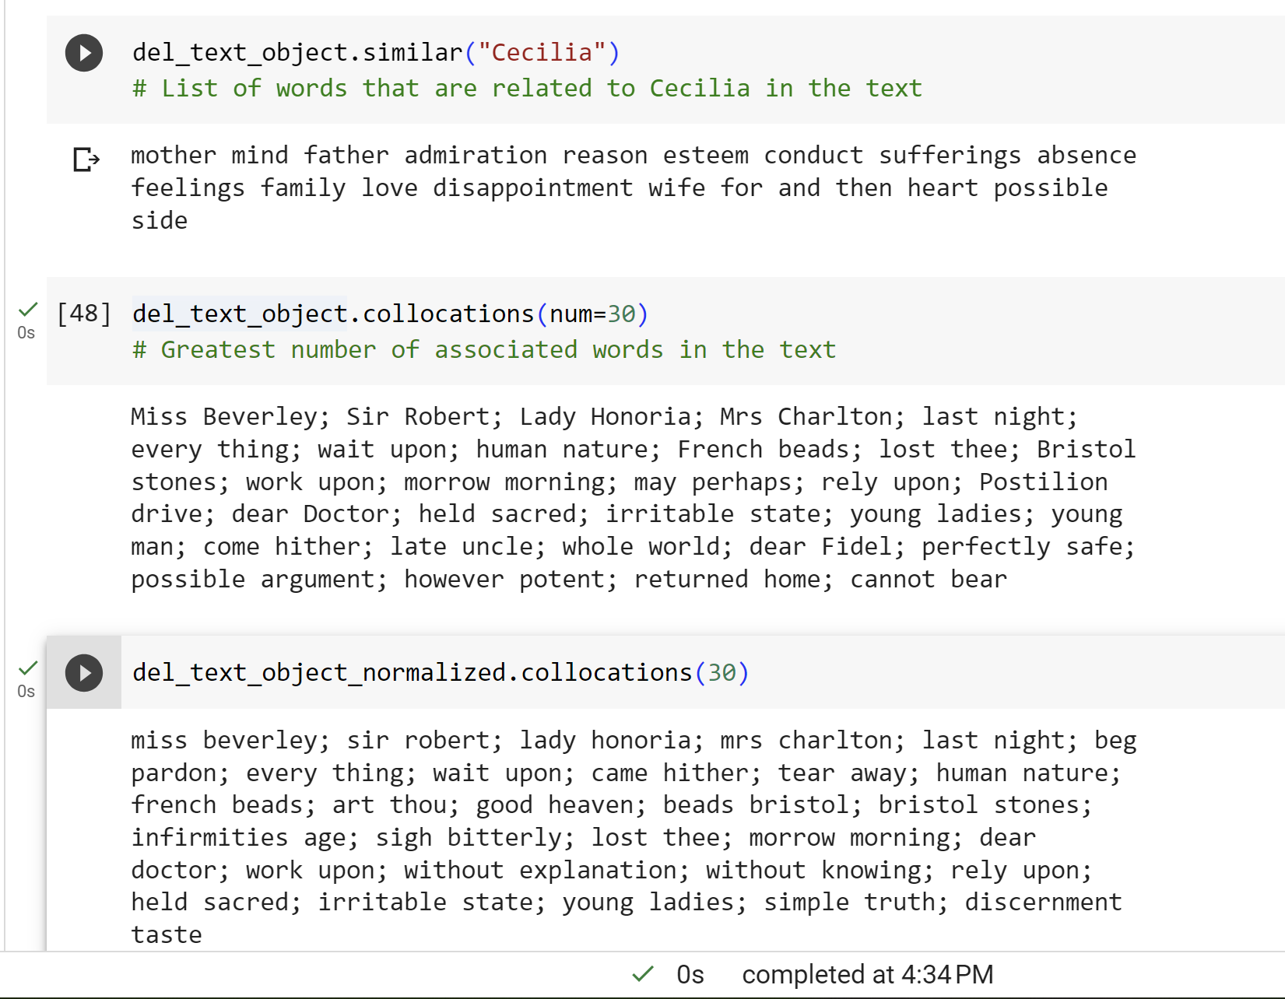
Sample Output from Natural Language Toolkit (NLTK)

Slide 37
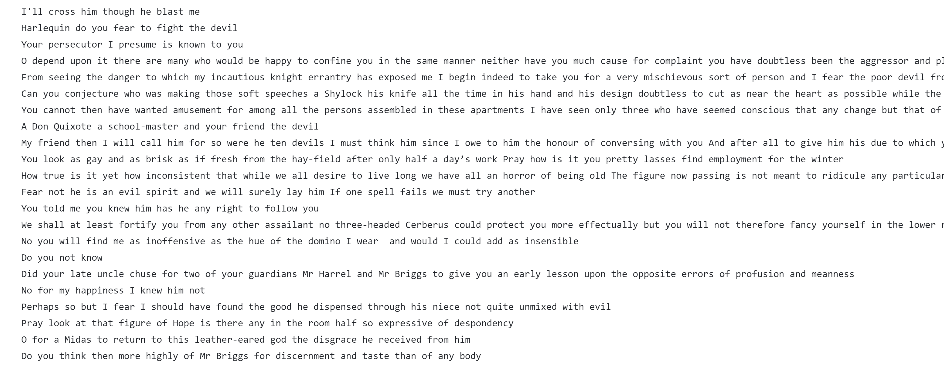
Sample Processed Text (delvile_sw.txt)
tiny.utk.edu/Cecilia

Slide 38
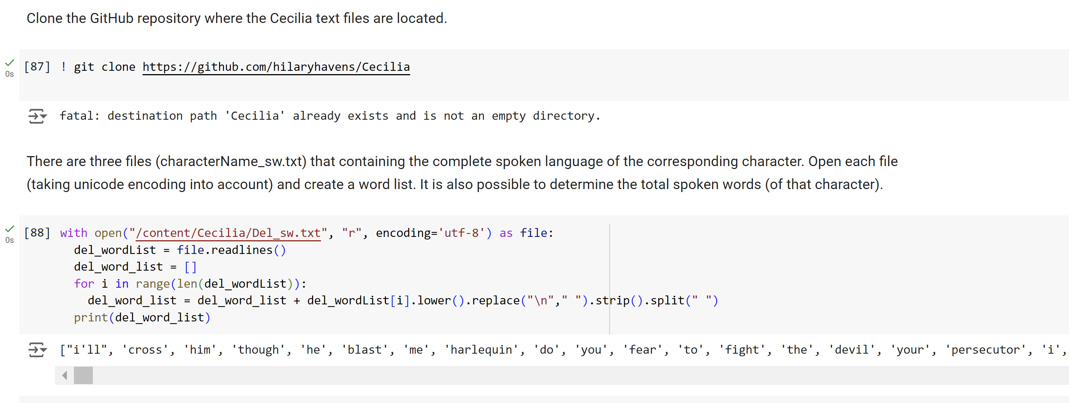
Sample Jupyter Notebooks Code
Cecilia_Language.ipynb
tiny.utk.edu/Cecilia

Slide 39
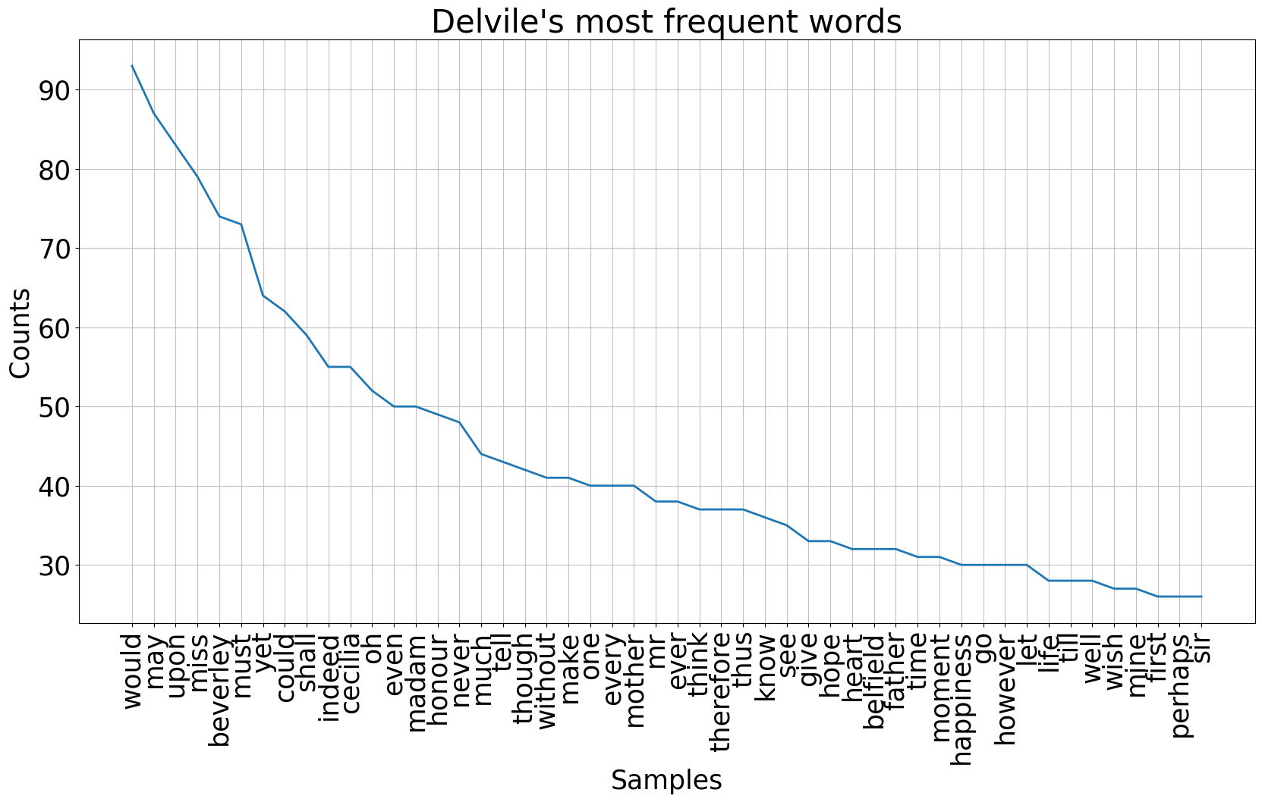

Slide 40
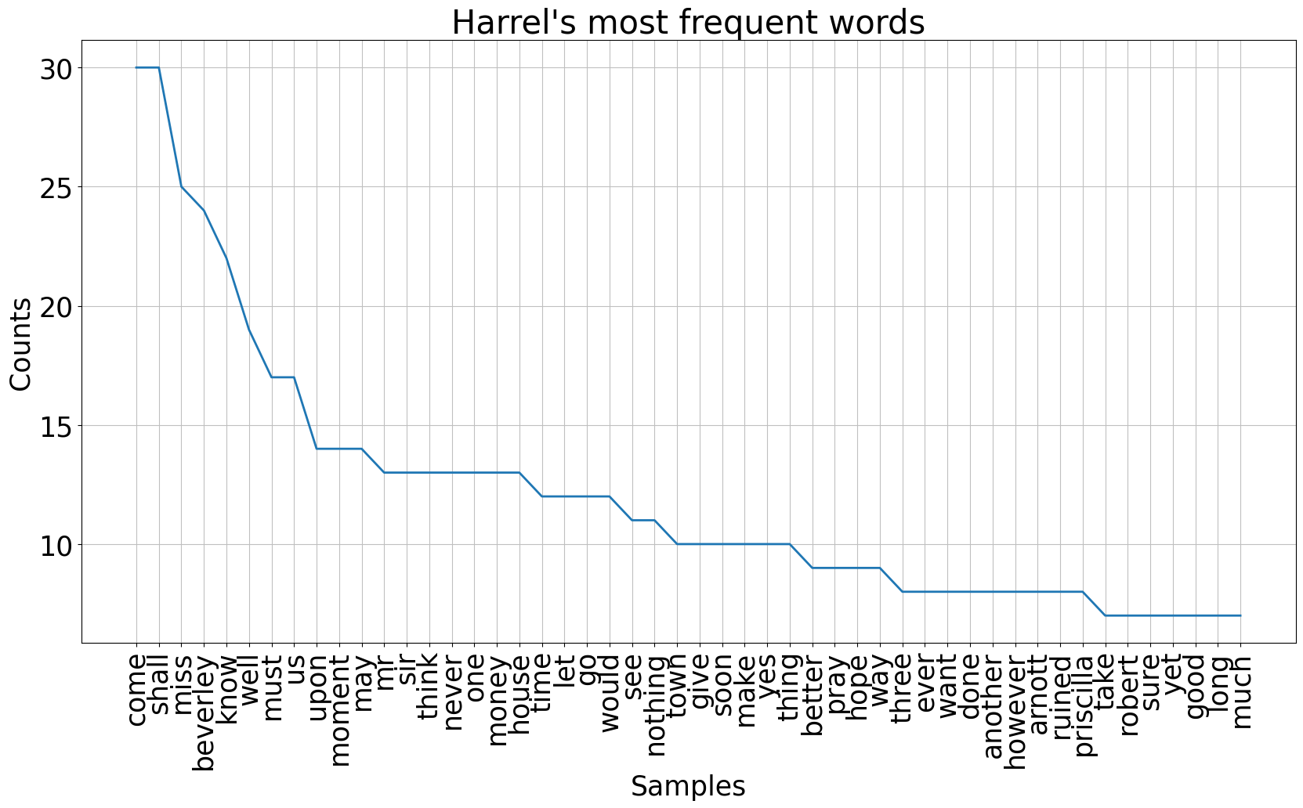

Slide 41
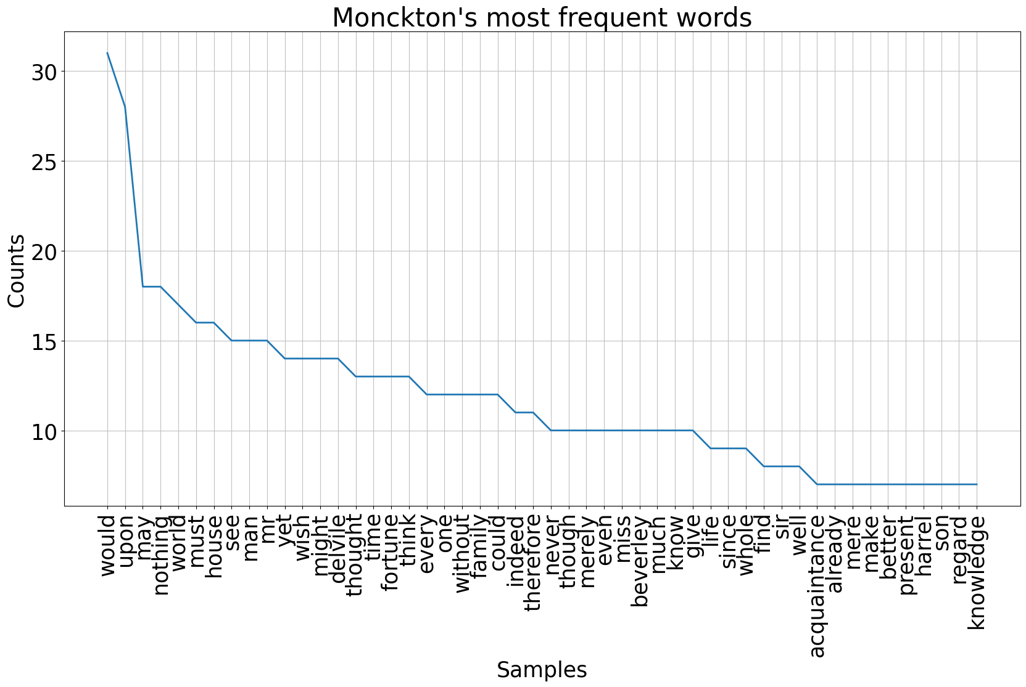

Slide 42
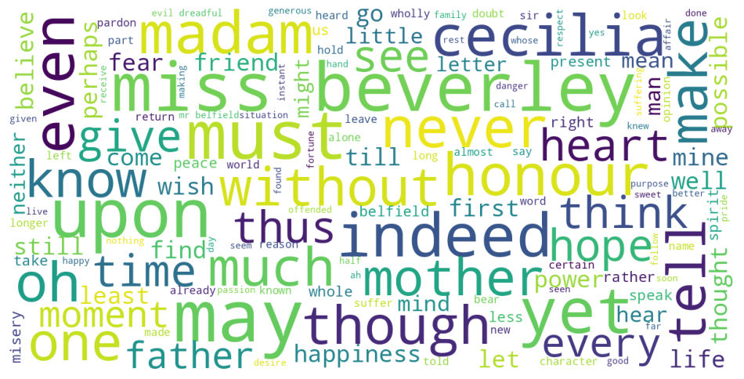
Delvile Word Cloud

Slide 43
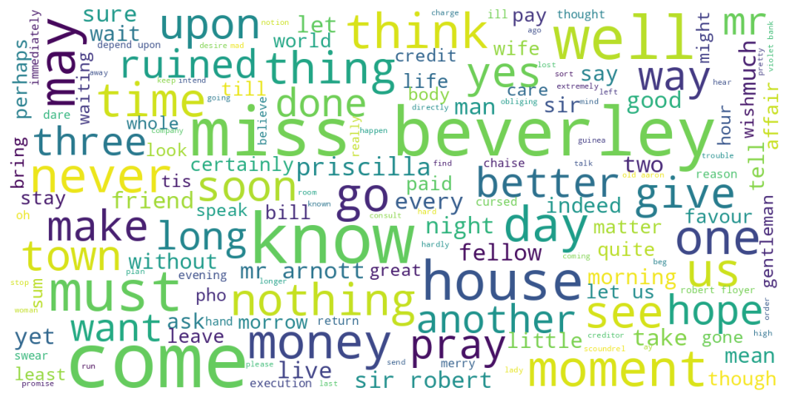
Harrel Word Cloud

Slide 44
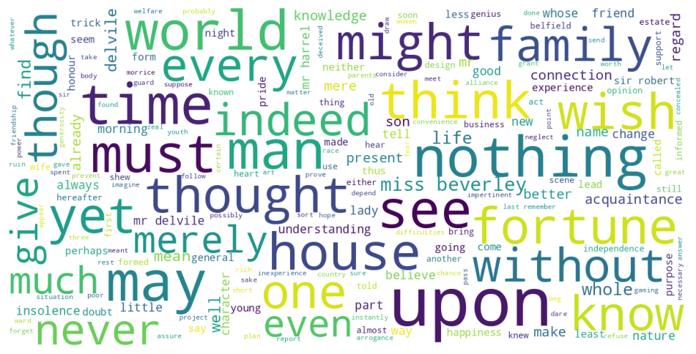
Monckton Word Cloud

Slide 45
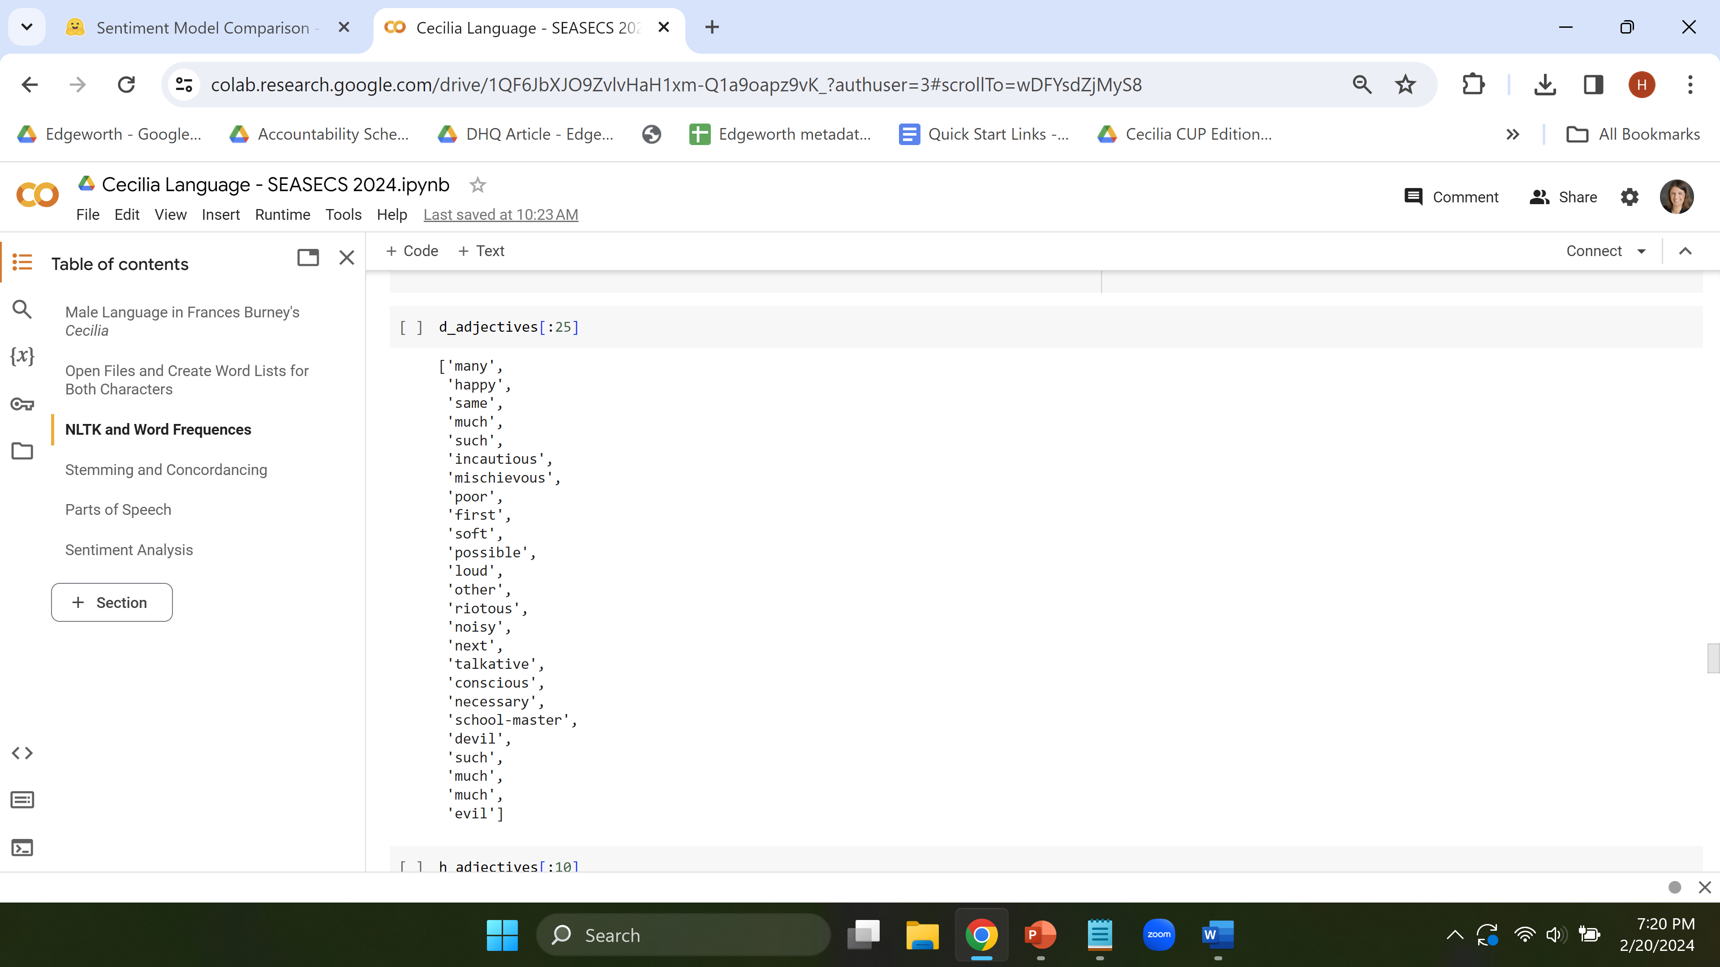
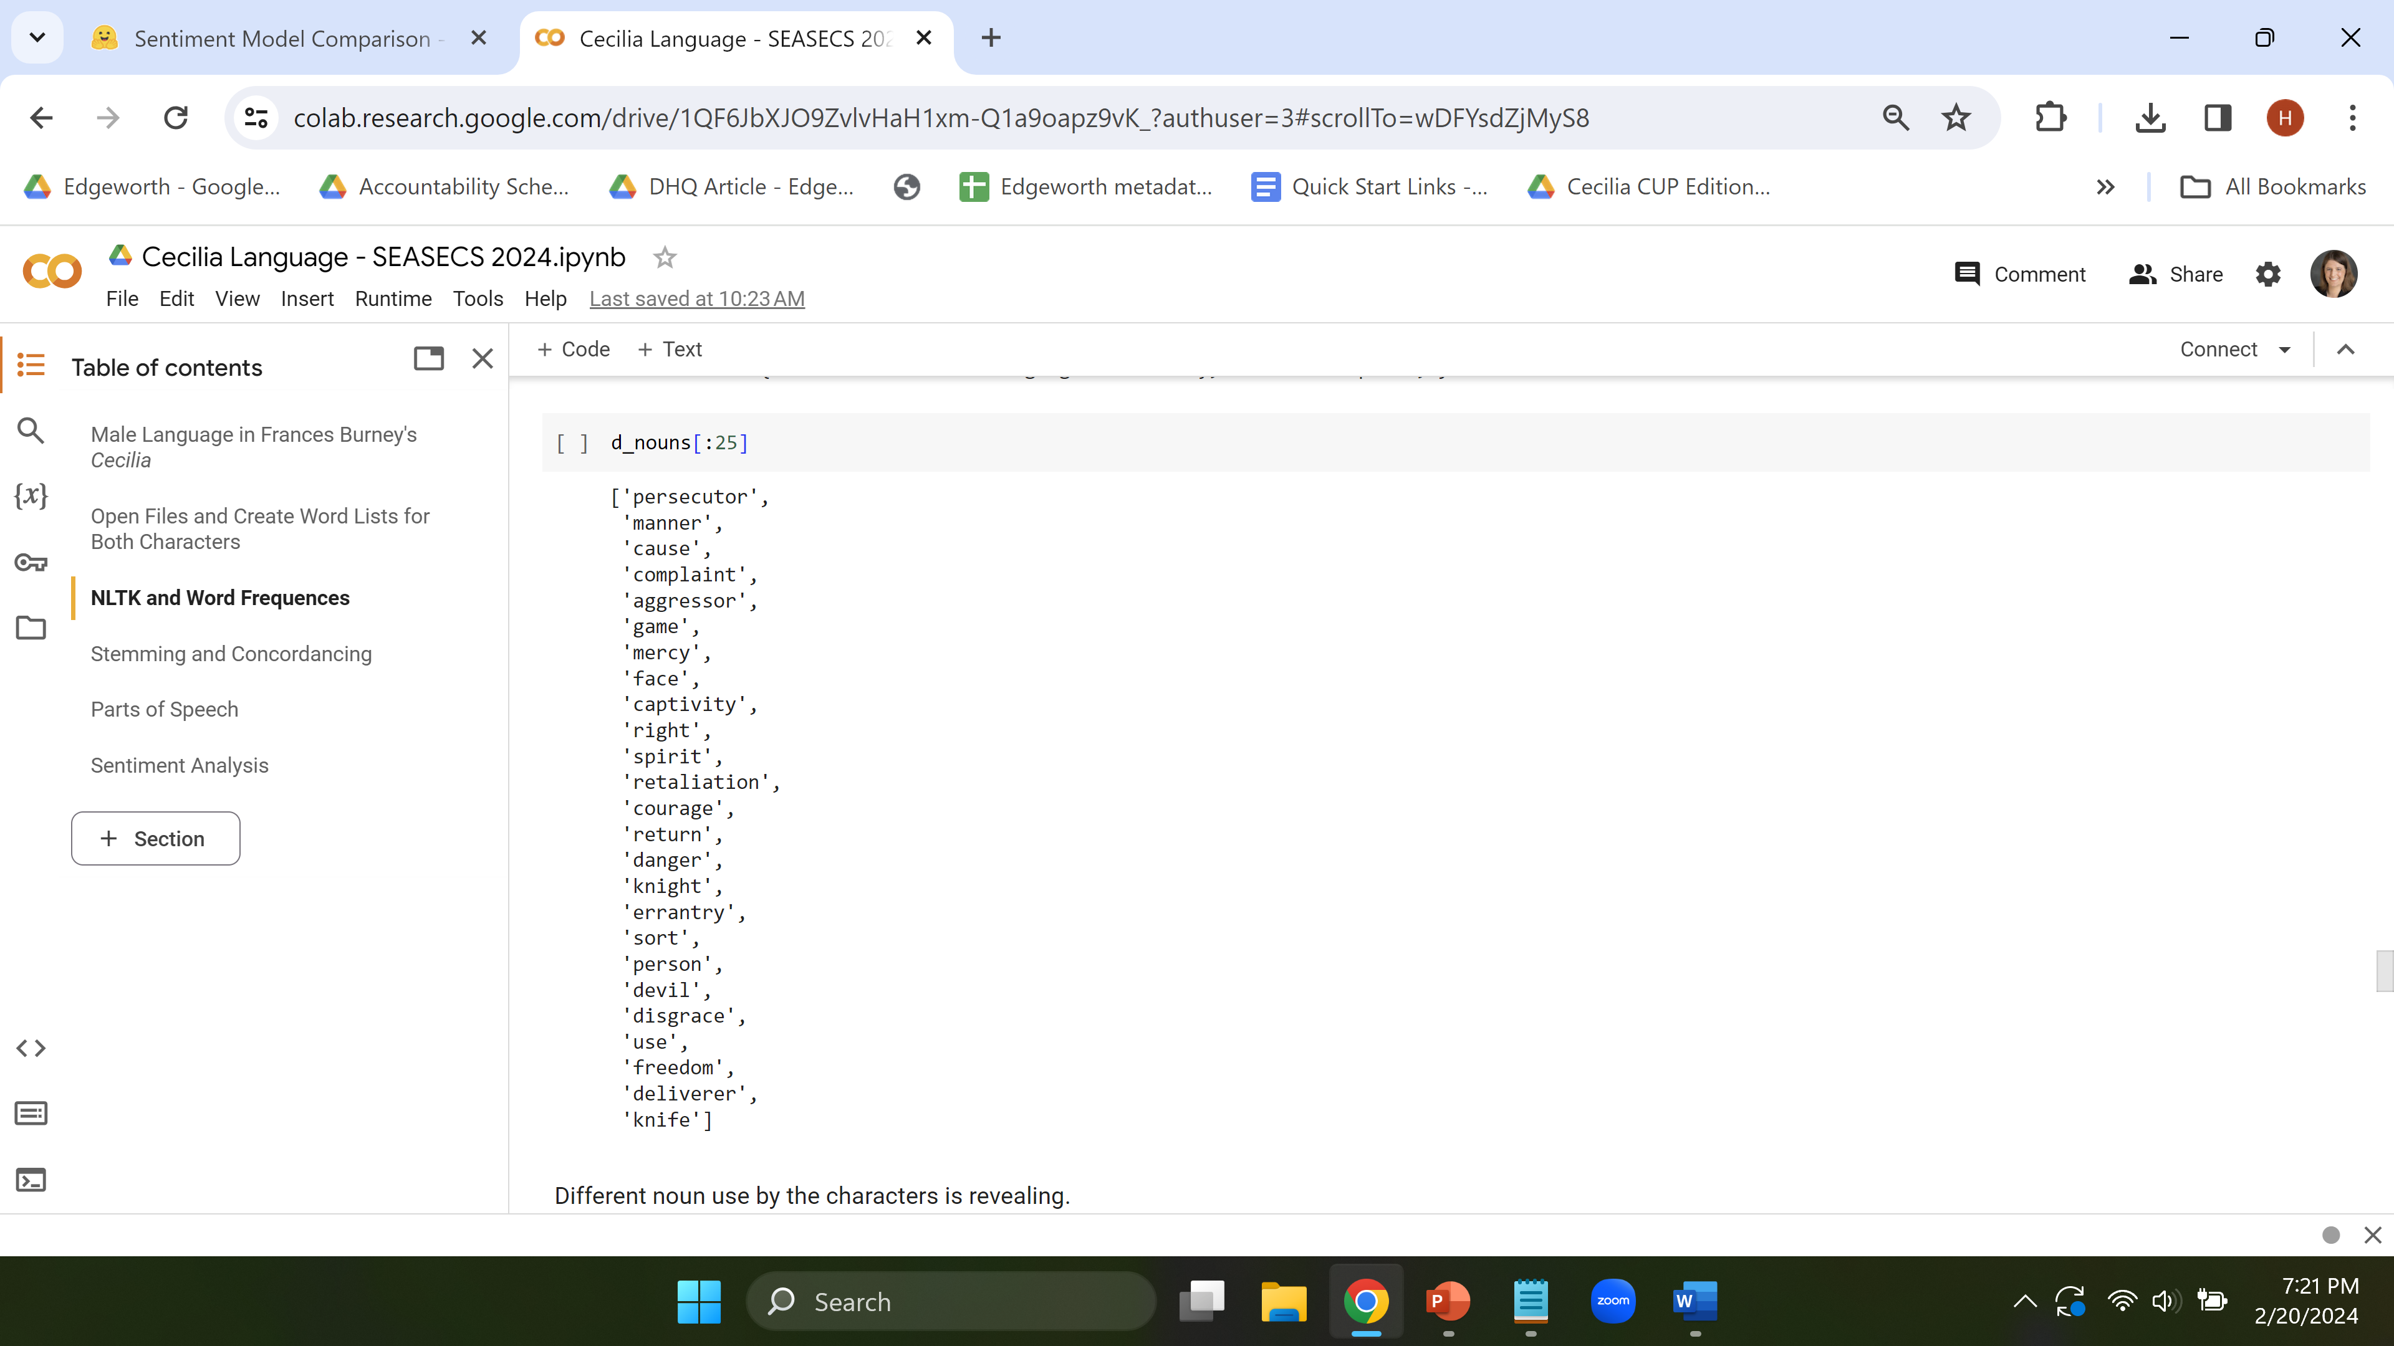
NLTK Parts of Speech Tagging

Slide 46
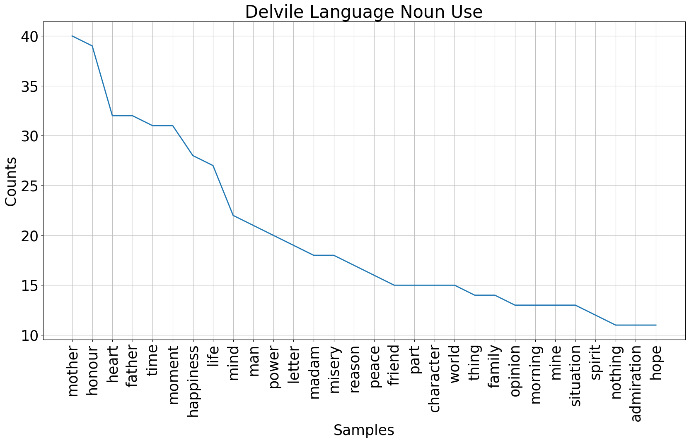

Slide 47
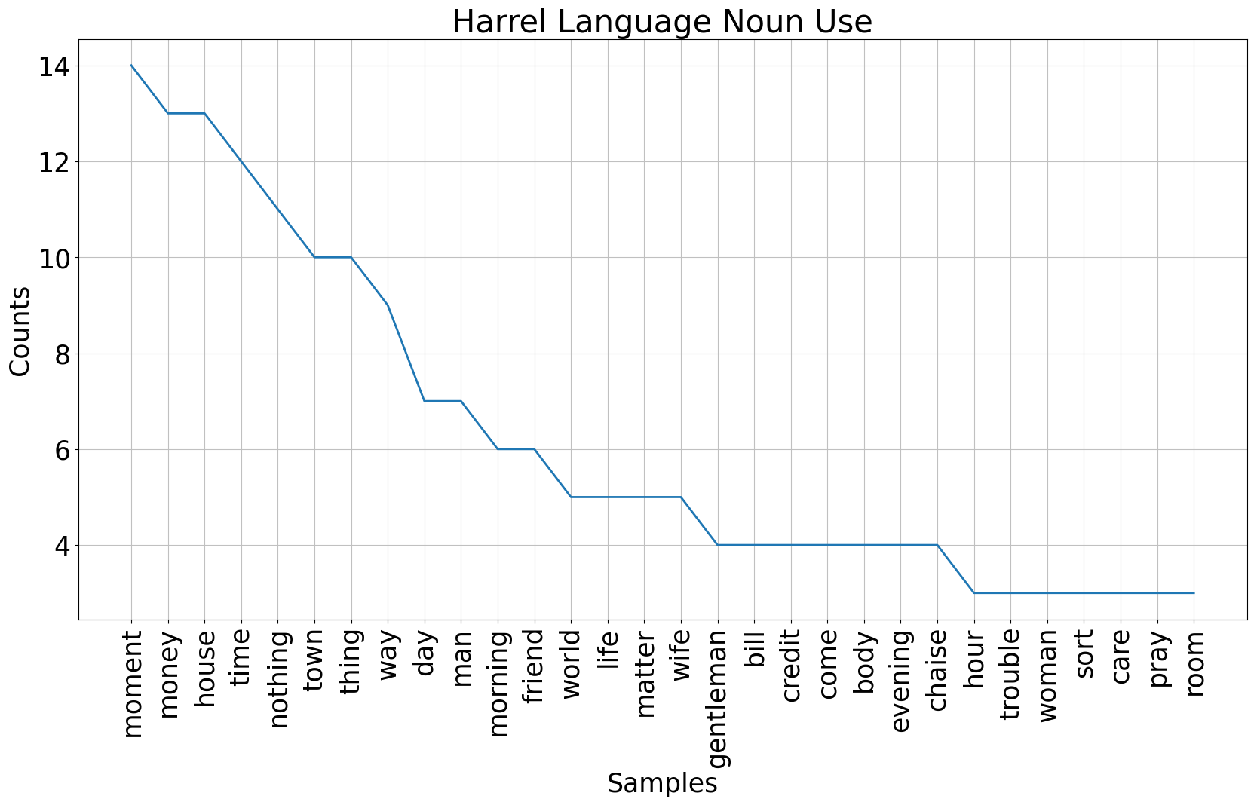

Slide 48
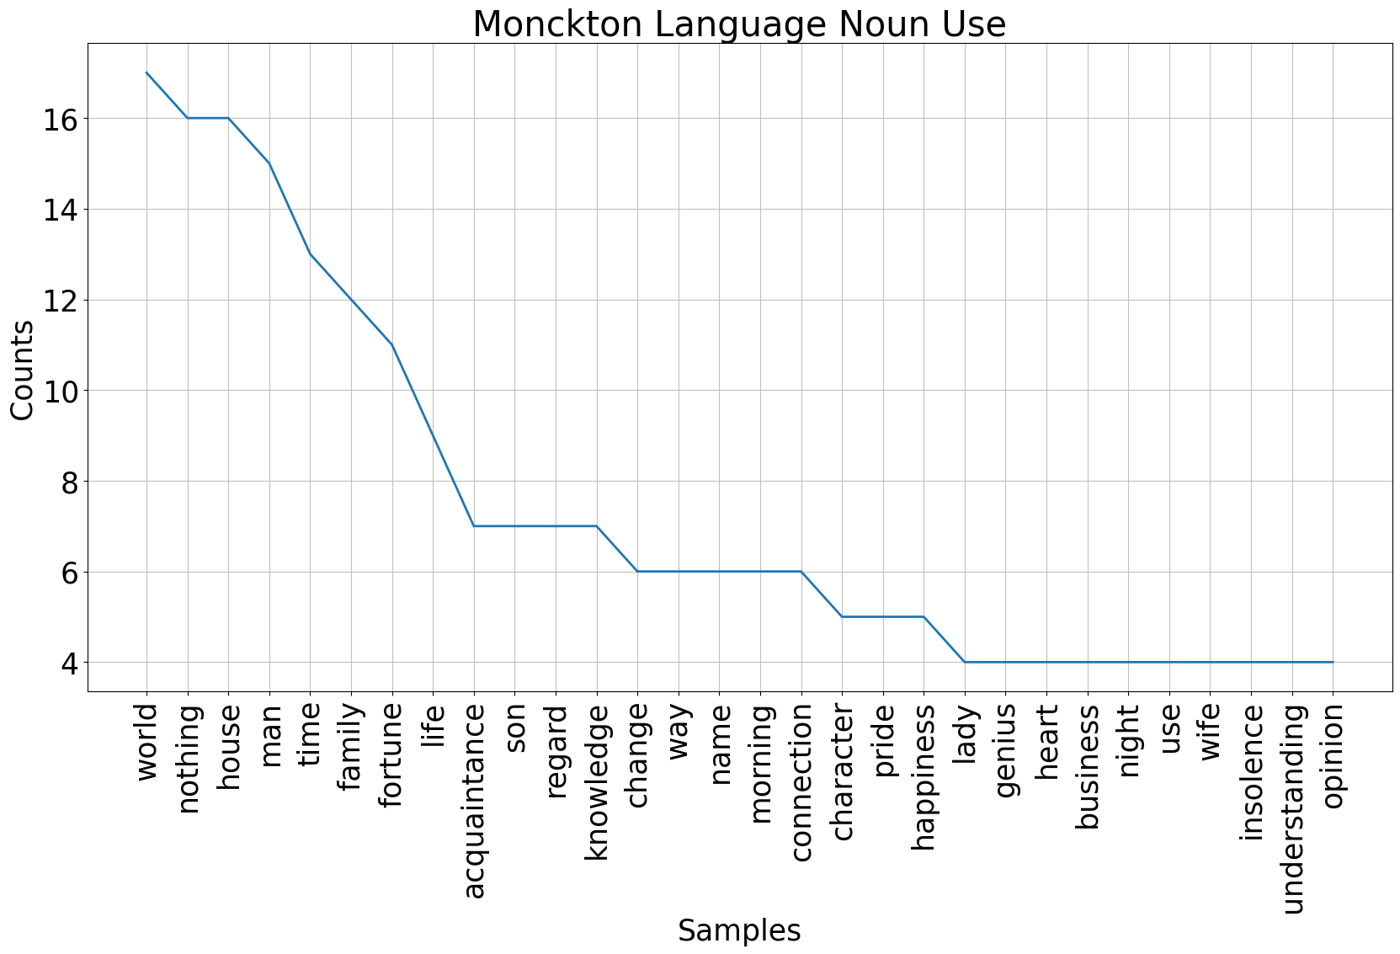

Slide 49
Link: tiny.utk.edu/Cecilia
Contact: hhavens1@utk.edu

